Slide 1
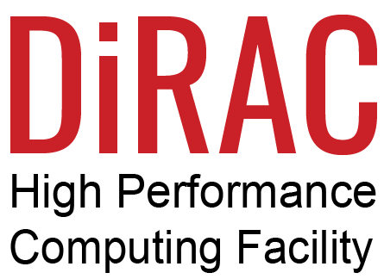
DDN
Datacentre Efficiency
Gareth Wilson
The AI Data Company
Notes:
For anyone who doesn’t know DDN – we’re the world’s largest privately owned storage vendor. Storage is the only thing we do and from day one we specialized in HPC and now AI too. Our first customer was NASA so we were off to a flying start, literally, and now we’re used in the largest HPC and AI platforms around the world such as the training for chat gpt on Microsoft co-pilot, fusion engineering research across all the US department of energy sites, and working on the SKA codesign team,

Slide 2
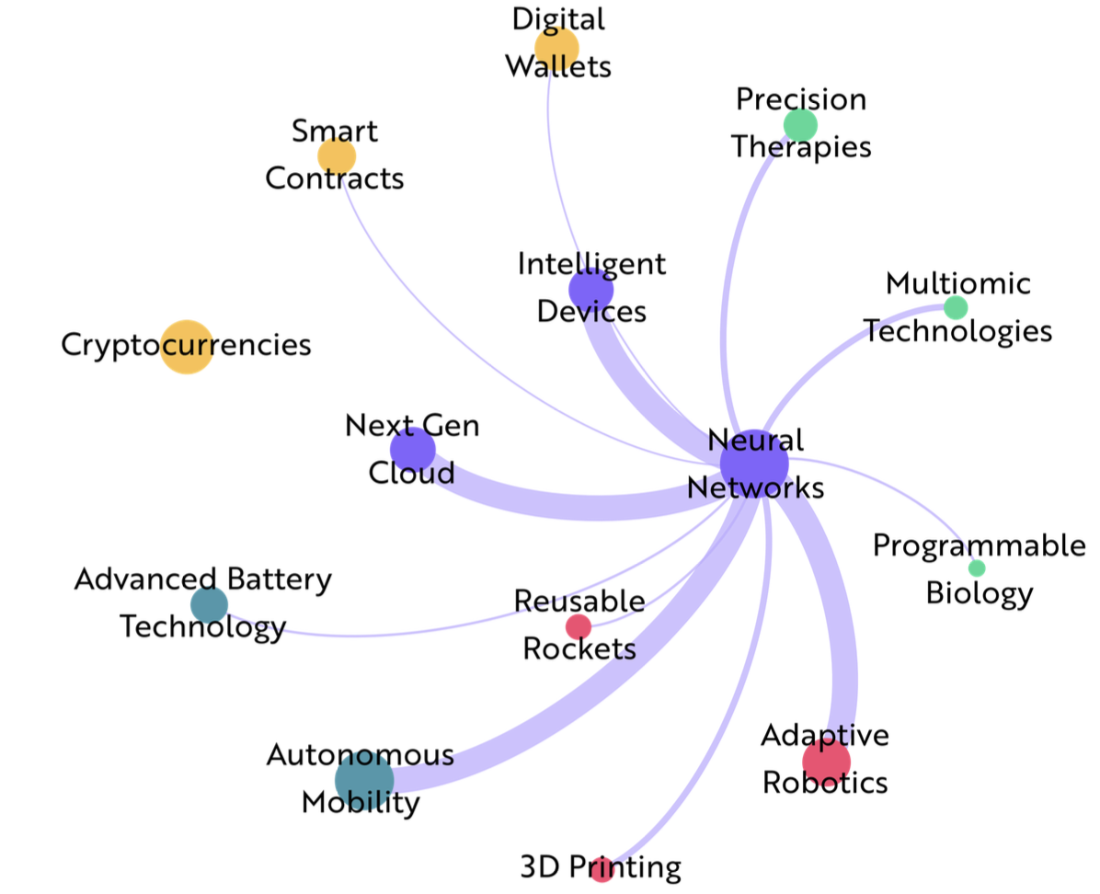
Our Era is Being Reshaped by Accelerated Computing
Adaptive Robotics
3D Printing
Precision Therapies
Programmable Biology
Reusable Rockets
Smart contracts
Next Gen Cloud
Intelligent Devices
Cryptocurrencies
Multiomic Technologies
Autonomous Mobility
Advanced Battery Systems
Digital Wallets
Revolutionizes chatbots
Drives value in financial services
Powers autonomous driving
Enhances personalized health
Creates dynamic experiences in gaming
ARK invest: Big Ideas 2023
Notes:
So if you’re a user why would you care about this? It’s all about delivering science faster, using the available resources to deliver more. Accelerated computing is how NVIDIA describe the convergence of HPC and AI –
we don’t just work with nvidia – we’ve optimized our storage for all the gpu accelerators from amd, intel, graphcore, cerebras etc but…

Slide 3
I have a very simple statement for you; NVIDIA uses DDN.
~ Manuvir Das | Head of Enterprise Computing | NVIDIA
DDN Confidential - NDA
Notes:
Why do nvidia use ddn –do we have some kompromat on this gentleman to make him publicy say this?

Slide 4
Accelerated Computing Requires a Full Stack
Optimization of AI Models, GPUs, Network, Data Centre
Data Management, Data Movement and Storage at Scale
Power Efficiency, Footprint, Workflow Acceleration
So, nearly everybody who thinks about AI, they think about that chip, the accelerator chip and in fact, it misses the whole point nearly completely
“
- Jensen Huang
Chief Executive Officer | NVIDIA
Notes:
There’s ever more parallelization in ai and you need the entire stack to work efficiently. We have done a lot of work on the data structures to allow file and object to reside on the same platform – save a file and export it as an object and vice versa with all the posix semantics translated into the s3 protocol or in reverse.

Slide 5
Machine Learning is Write and Read Intensive
- Analysis of over 23,000 Machine Learning Jobs
“Most ML jobs are perceived to be read-intensive with a lot of small reads while a few ML jobs also perform small writes.”
“Our study showed that ML workloads generate a large number of small file reads and writes…”
Small Writes
Small Reads
Characterizing Machine Learning I/O Workloads on Leadership Scale HPC Systems
https://arnabkrpaul.github.io/publications/mascots21.pdf

Slide 6
Spend is Large, Risks are High. How can Storage Help?
A Storage System typically represents 5% of the 3 year Capex & Opex budget of an AI system for Deep Learning/LLM training
IO Wait and associated elements of the training process can consume up to 43%¹ of runtime
How can the efficiency architecture and consumption of storage resources impact overall productive output of this System?
Datacenter, Power & Cooling
Support
Ancillaries
Networking
GPU/IPU/CPU
Infrastructure
Storage
1 (Maeng et al., 2021).

Slide 7
DDN Increases AI Data Center Productivity Making the Storage Free
By reducing storage wait time for Load, hugely reducing wait time for checkpoints, and enabling more checkpointing to eliminate lost time of recomputation, DDN reduces data center runtime by 5-12%, delivering higher productivity to LLM’s and Generative AI.
Spend $1 on DDN, gain $2 in Infrastructure productivity
5-25% faster
Data Initial Load
checkpoint
Training

Slide 8
Parallel Filesystems Enable Scale Efficiency
An Efficient Architecture
You can never get efficiency with this architecture.
NFS Client - limited parallelism, slow. Needs Servers to find the data
AI
AI
AI
AI
AI
AI
AI
AI
NFS
Intelligent Client knows where the data is
Server
Server
Server
Server
Complicated Additional Network
Data
Data
Data
Data
No Backend Interconnect
Too many unnecessary data movements between buffer and main store. Too much Hardware.
Buffer
Buffer
Buffer
Buffer
Data
Data
Data
Data

Slide 9
Today’s QLC Scale Out NAS Are Highly Inefficient
Low IOPS and Throughput per Server
10x lower IOPS than DDN in 3x the footprint
Low Per-Port Performance
Customer needs 10x more switch ports for performance
servers
Very Low Write Performance
12x less write performance compared to DDN
Backend Switching
Adds complexity and Cabling. Makes it difficult to expand
10x More Cabling
Expensive and complicated cabling at the back end. More to Fail and more to manage
JBOF
Everything is Tiered
Poor Write Performance
Lowers Efficiency with many data movements per write
High Latencies
Poor Metadata Performance

Slide 10
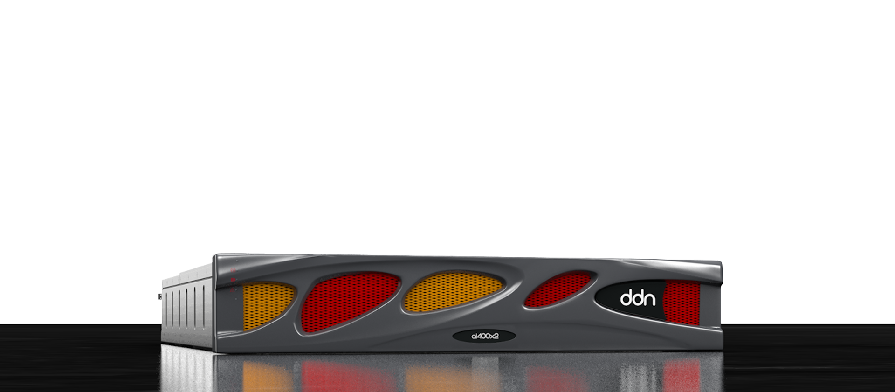
In 2RU and 2KW DDN Delivers:
90GB/s
3M
READS
IOPS
65GB/s
Up to 720TB
WRITES
NVMe TLC CAPACITY

Slide 11
World’s Most Performing and Flexible Storage At Any Scale
TLC Flash
QLC Flash
Hybrid
Best IOPS & Throughput per rack
Up to 70M IOPs in a single rack
1.8 TB/s of read throughput
1.4 TB/s of write throughput
16PB of Flash
Best Price per Flash TB
Up to 14M IOPs in a single rack
360 GB/s of read throughput
240 GB/s or write throughput
Up to 26PB of Flash
Best Price per TB
20PB per Rack
90 GB/s of read throughput
65 GB/s of write throughput

Slide 12
DDN Delivers Highest Performance AND Highest Endurance in QLC
The Fastest QLC Appliance
Read: 90GB/s Write: 70GB/s, IOPs: 3M
Fully Flexible and Scalable Expansion
Add 2, 4 or 5 SE 2420 QLC Expansion Enclosures
Highest Density
Between 1 and 6 PB QLC Capacity
Simplest Redundant Infrastructure
DDN embedded NVMeoF network
- No External Switches

Slide 13
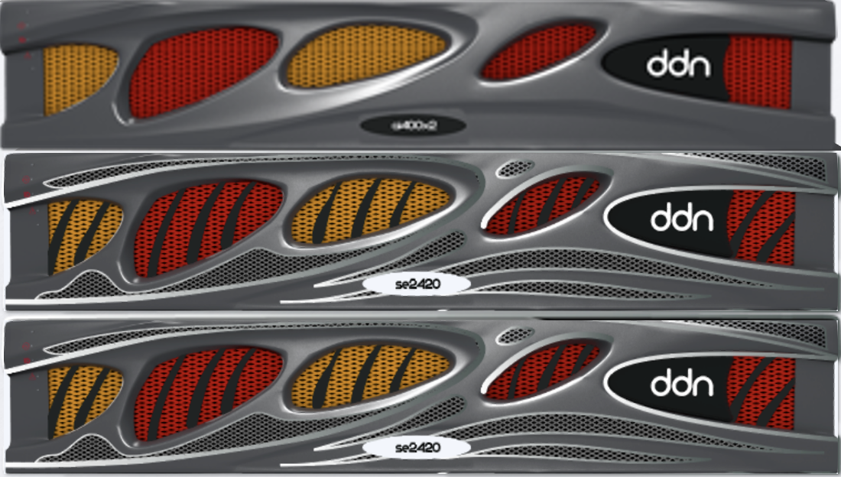
QLC Optimized for Performance or Capacity
Optimized for Performance/$
Optimized for Capacity/$
630GB/s
270GB/s
READ Performance
READ Performance
490GB/s
210GB/s
WRITE Performance
WRITE Performance
14PB
24PB
Capacity
Capacity

Slide 14
Build to Specification: Price - Performance - Capacity
TLC
QLC
QLC
TLC
QLC
QLC
Hybrid
90GB/s
500TB
90GB/s
2PB
90GB/s
5.5PB
900GB/s
5PB
270GB/s
6PB
630GB/s
14PB
90GB/s
19PB
Notes:
So why don’t we win every deal?

Slide 15
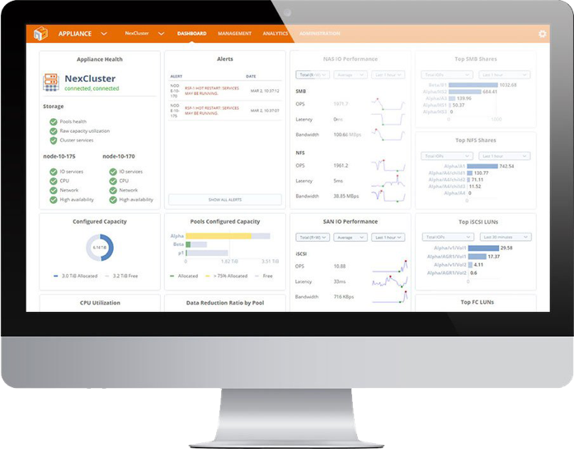
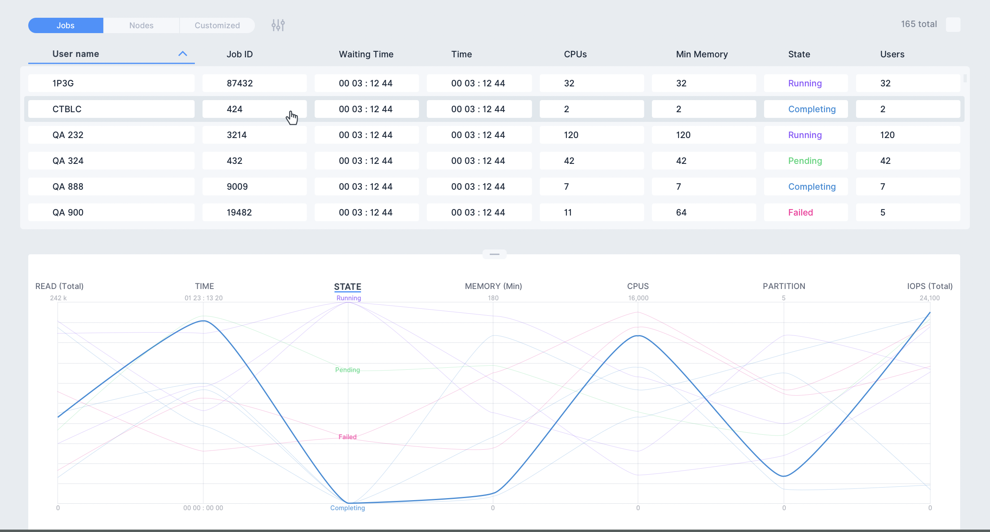
With DDN Analyze Live Workloads and Full History
Real Time Job Monitoring
Historical Job Analysis¹
DDN NDA ONLY
1 – DDN Insight 4.3 – H1 2023

Slide 16
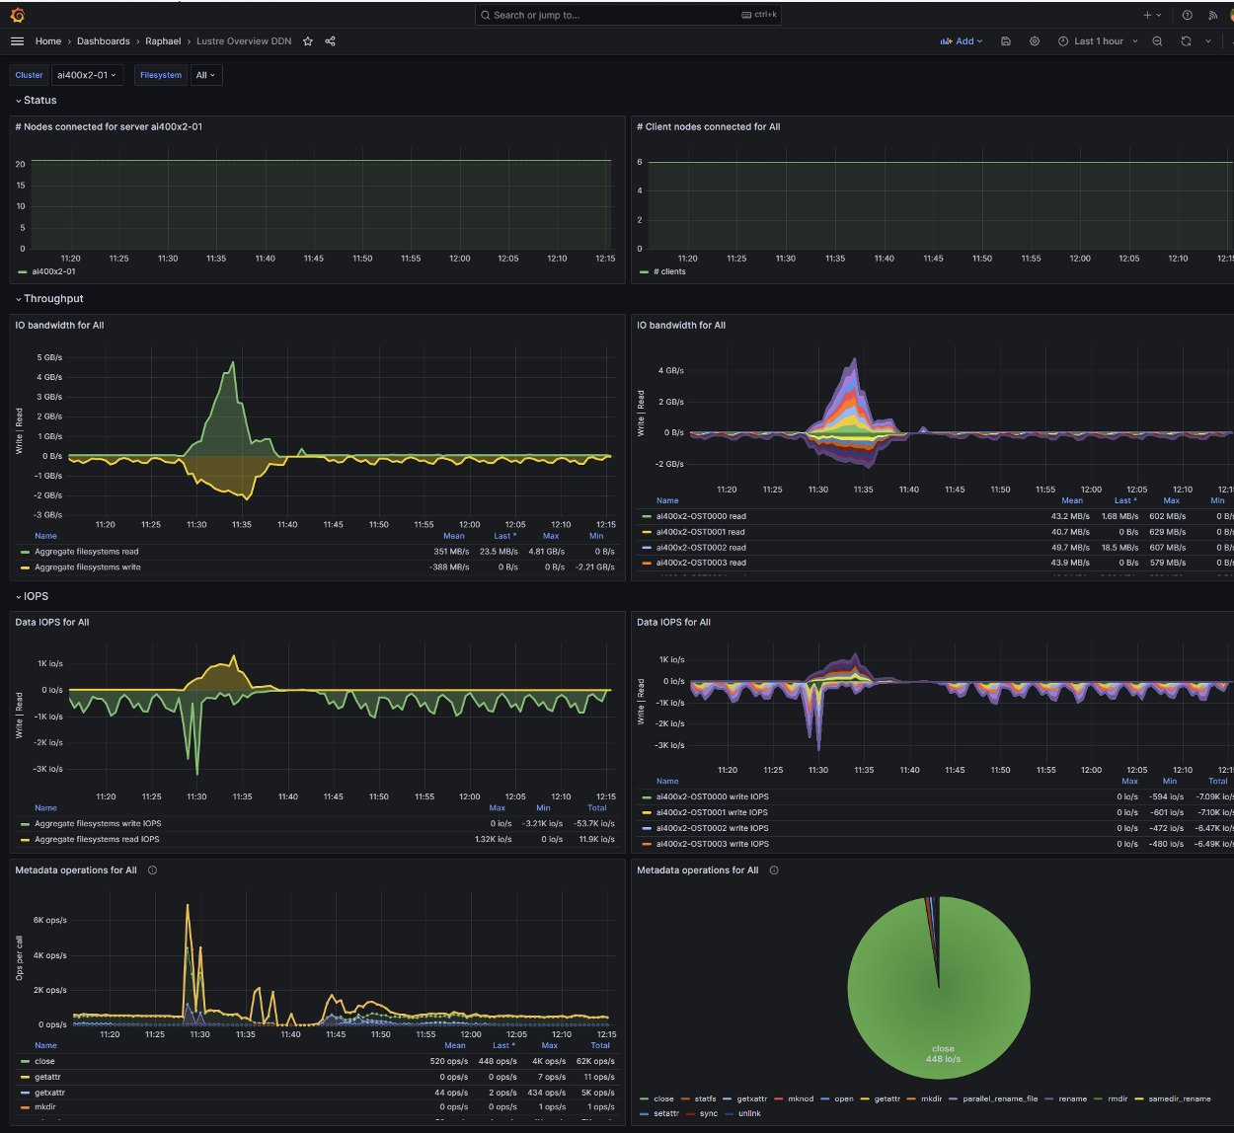
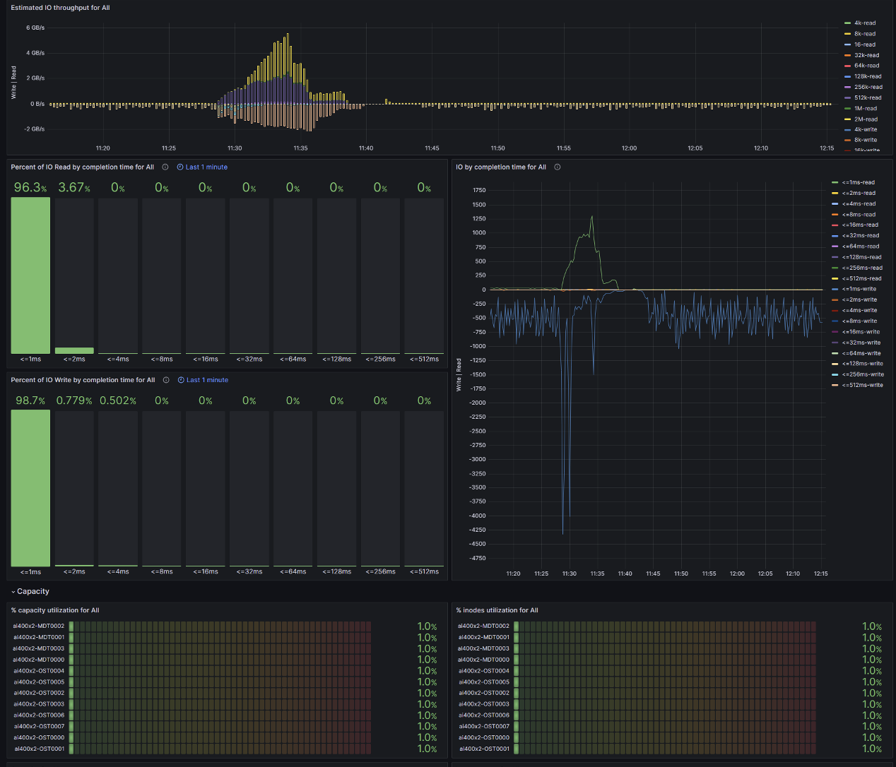
Prometheus Exporters Enable Open Integration
Real Time Job Monitoring
DDN NDA ONLY
Preview Available Now, GA H1 2024

Slide 17
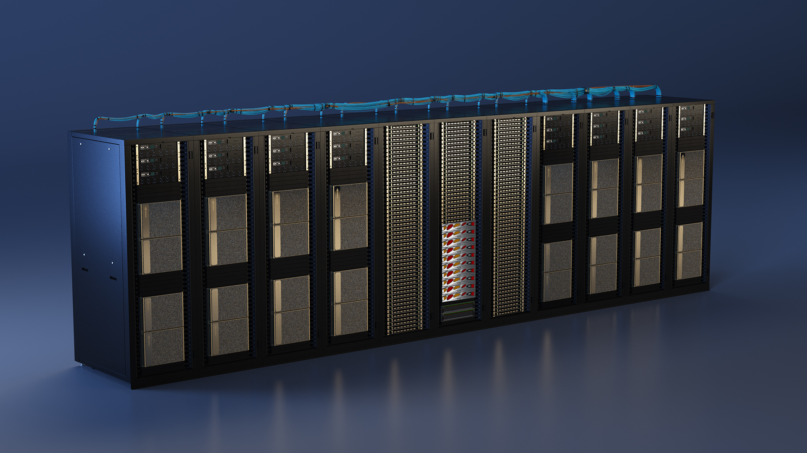
DDN Makes the Storage Which Drives Advances in AI, HPC, Life Sciences, Finance, Autonomous Cars at Any Scale
“
10X Faster. 10X More Capacity. 10X Less Power and Footprint

