Slide 1

WEKA – Efficient Use of Modern Hardware
Chris Weeden (Senior Systems Engineer)
December 2023

Slide 2
WELCOME TO WEKA
FOUNDED IN 2014
ENGINEERING HQ IN TEL AVIV
CORPORATE HQ IN CALIFORNIA
PRODUCT
The WEKA Data Platform, software-defined, parallel file system leveraging NMVe and high speed networks
FINANCE
$135M SERIES D INVESTMENT in NOV ‘22, 3 X GROWTH ACHIEVED BY END OF Q3, INVESTMENT FROM MANY TECHNOLOGY PARTNERS & VCs
CUSTOMERS
8 of the FORTUNE 50
(FINANCE, HEALTHCARE, MANUFACTURING, OIL & GAS)
GOVERNMENT, DEFENCE, ACADEMIA/RESEARCH

Slide 3





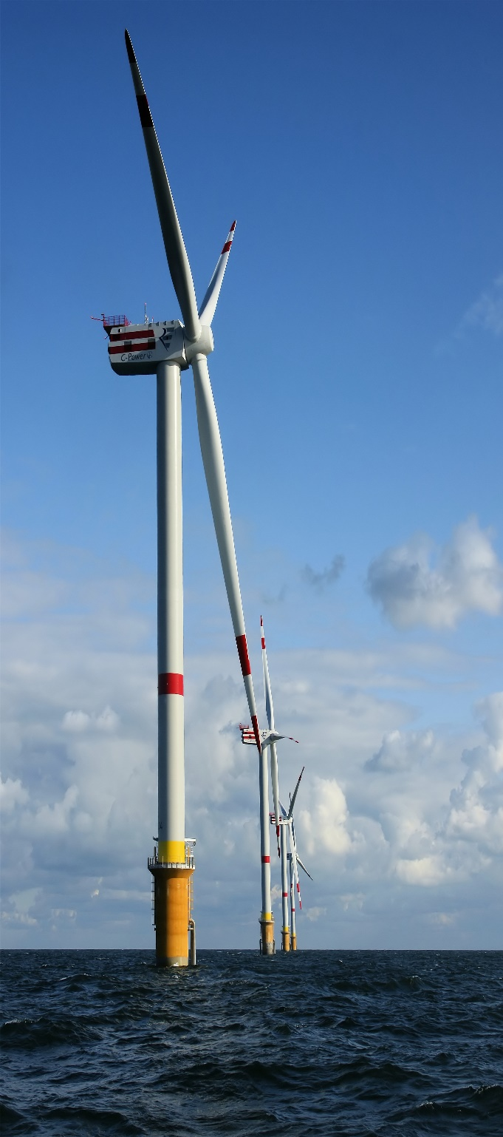
CUSTOMER MARKETS & USE-CASES ACCELERATED BY WEKA
ACADEMIC HPC & AI
------
INCREASING NATIONAL SECURITY
---
LIFE SCIENCES RESEARCH
---
NATIONAL LABS
---
ASTROPHYSICS/PLANETARY DEFENSE
---
CLIMATE/WEATHER/OCEANOGRAPHIC SIMULATION
---
PUBLIC
SEISMIC PROCESSING
------
RESERVOIR SIMULATION
---
CFD/CSM
---
WEATHER FORECASTING
---
AI FAULT DETECTION
---
ENERGY
INCREASING PROFITABILITY FOR FINANCIAL TRADING
---
REDUCING FRAUD
---
REDUCING RISK
---
IMPROVING BUSINESS PERFORMANCE THROUGH PREDICTIVE/PRESCRIPTIVE ANALYTICS
---
FINANCE
ACCELERATING DRUG & VACCINE DISCOVERY
---
PRECISION MEDICINE
---
MORE ACCURATELY DETECTING VARIANTS & DISEASES
---
IMAGE RECOGNITION/ANOMOLY DETECTION
---
LIFE SCIENCES
WINNING THE RACE TO LEVEL 4 VEHICLE AUTONOMY
---
CFD/CSM
---
IMAGE RECOGNITION/
FAULT DETECTION
---
EDA
---
MANUFACTURING
VFX PIPELINE
---
POST-PRODUCTION
---
PLAYOUT
---
CODEC DEVELOPMENT
---
GAMING
---
MEDIA & ENTERTAINMENT

Slide 4










THE WEKA DATA PLATFORM IN A PRODUCTION ENVIRONMENT
(GPUDirect)
Compute
S3
S3
ETHERNET OR INFINIBAND
NVMe – Up to 512 Petabytes
SSD Capacity
Features Including:
Virtual File Systems
Per File System Tiering
Snapshots
Snapshot Backups
Snap to cloud
Encryption
Data Reduction
Secure Organisations
OBS Capacity
(Optional)
TRANSPARENT NAMESPACE
EXTENSION
PRIVATE
PUBLIC
Weka Client
UNIFIED WEKA NAMESPACE – Up to 14 Exabytes
WekaFS
Notes:
Slide 11
And here's a visual of what a weka would look like in production.
You can see typically you'll have your GPU or HPC cluster, but you can also have standard applications running against the data set as well. If you want to share the data with users who use Linux systems or Windows systems they can have access to the data as well.
The storage nodes can be from any of the major OEM vendors that we have reference architectures with, including HPE,Dell, Supermicro, Lenovo or Cisco or other. We don’t mind what systems you use.
Whatever your preferences, you take an NVMe server and then we create a storage cluster which we present up to your HPC nodes, which is very high performance and gives you maximum bandwidth an internally transparent to your application. We have a data lake based on S3 storage and that can be on premises for best performance, but you can also utilize the public cloud. So again, it's very flexible and the key thing is all your data is always available to your namespace.

Slide 5
NVMe locality doesn’t matter
Local copy architectures were developed when 1GbitE and HDDs were standard
Modern networks on 100Gbit are 100x faster than SSD
It is much easier to create distributed algorithms when locality is not important
4KB IOs latency similar to local FS, bigger IOs parallelize, so even lower latency
Flash Memory Summit 2018
Santa Clara, CA

Slide 6
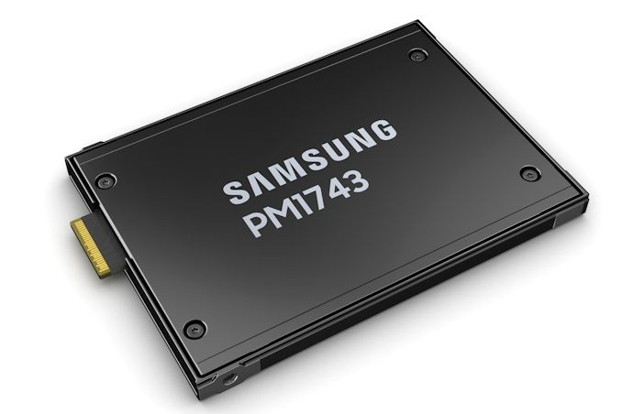
NVMe locality doesn’t matter
NVMe Speeds
PM1743 U.2 NVMe SSD Pcie 5
Latency 4KB random Read/Write is 90/20 microseconds
(Measured with FIO and 4KB transfer size with queue depth 1 on a random workload of sustained state)
NIC Speeds
NIC speeds: 200G today, 400G soon
At 400G, a 4kB packet is 80 nanoseconds
  Less than a single cache miss
400Gbit is 10% of server memory bandwidth
(https://www.irtf.org/anrw/2023/slides-117-anrw-sessa-keynote-its-the-end-of-dram-as-we-know-it-02.pdf)

Slide 7
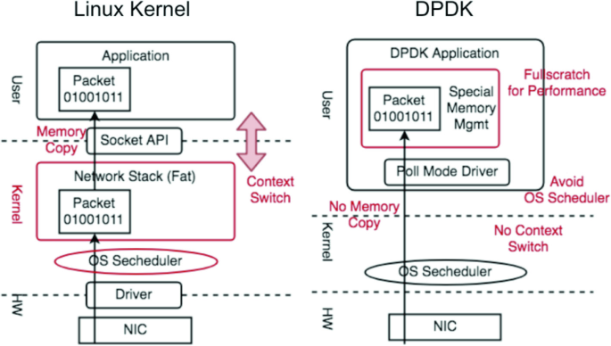
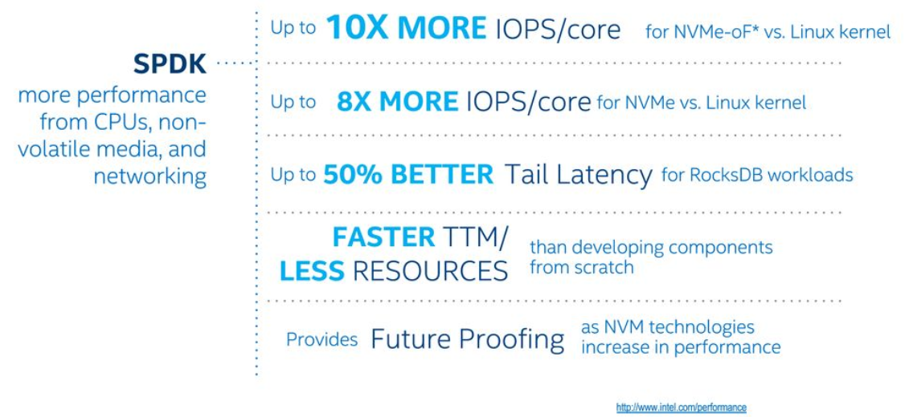
User Space to Hardware Plumbing – Kernel Bypass
Multiple Virtual NICs
Benefits of SPDK

Slide 8
Software Architecture - Dedicated
WEKA Storage Host
Application Server (WEKA Client)
User
Space
LXC Container
LXC Container
Application
Drive
(WEKA NVME-oF)
Compute
(Data placement, data protection, FS metadata, Tiering)
Front End
Client Access
(NFS, S3, SMB, GDS)
Front End
Client Access
(POSIX)
Networking
Networking
POSIX
SPDK
DPDK
Kernel Module
Kernel
Kernel
H/W
WEKA L5
Protocol over IP
Notes:
The LXC containers contain software instances that WEKA calls Nodes and communicate with each other to provide storage services in the cluster. Nodes are dedicated to managing different functions such as (1) Drive nodes for NVMe Drives and IO to the drives, (2) compute nodes for filesystems and cluster-level functions and IO from clients, (3) frontend nodes for POSIX client access and sending IO to the compute and drive nodes, and (4) management nodes for managing the overall cluster. Management nodes are not shown in this picture as they are not in the data path, and do not require dedicated compute cores to run.

Slide 9
Software Architecture - Converged
WEKA Storage Host
User
Space
LXC Container
Application
Drive
(WEKA NVME-oF)
Compute
(Data placement, data protection, FS metadata, Tiering)
Front-End
Client Access
(POSIX, S3, NFS, SMB)
Networking
SPDK
DPDK
Kernel Module
Kernel
Kernel
H/W
WEKA L5
Protocol over IP
Notes:
Similar to the dedicated deployment model, a converged deployment still has the LXC container for the core storage services, but now the front end on the storage host directly interacts with the kernel driver against local applications that do not reside in the container. The advantage here is that with modern multicore CPUs, you can now combine storage and applications on the same hardware, resulting in a smaller overall HW footprint for the combined high-performance storage and applications. In addition to this, the Weka Cluster can *still* communicate with other clients across all of the protocols mentioned before, resulting in a flexible hybrid of converged and non-converged storage.

Slide 10
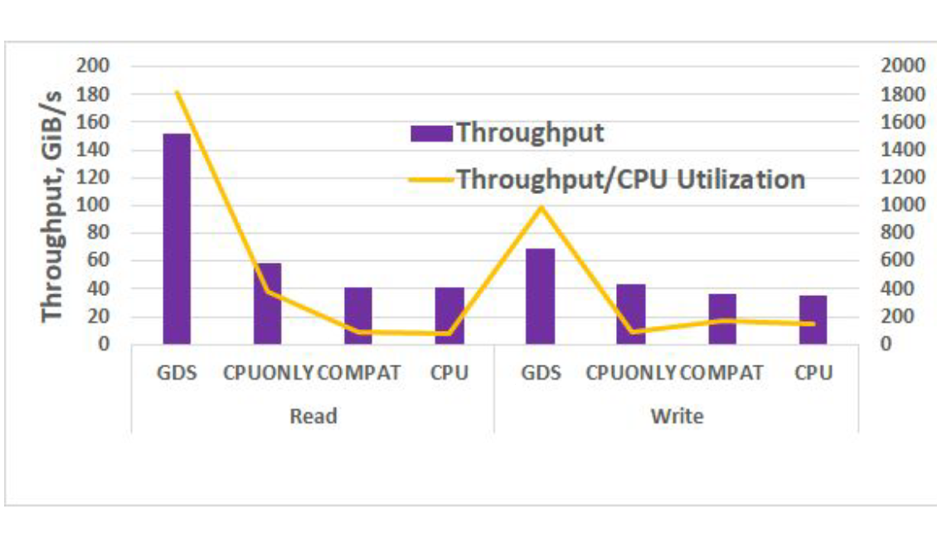

Performance…
WekaFS achieved 162 GiB/s and 43.5M IOPs to a single DGX-A100
8x 200Gbit HDR links.
High throughput on direct path leaves the CPU relatively idle
2.4ms latency with GDS on reads vs. 4.8ms without GDS
Ratio is similar for writes but longer

Slide 11
Performance…
1x 400 GbE CX7 client performance to a single mount point:
Read throughput: 45.8 GB/s a.k.a. 366 Gbps
Write throughput: 42.8 GB/s a.k.a. 342 Gbps
Read IOPS: 2,477,170
Write IOPS: 2,025,559
AMD EPYC 9354P 32-core 3.25GHz processor.
Throughput tests were done with numjobs=32.
IOPS tests were done with numjobs=88.
fio version 3.19

Slide 12




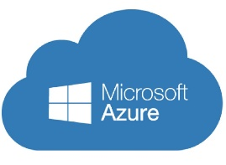














The WEKA Data Platform: Platform Independent
Built on WekaFS, software-defined parallel file system
NVMe Platforms
Object Storage Platforms
Single
Shared Namespace
WEKA-as-
a-Service

Slide 13
WEKA: FEATURE RICH AND FLEXIBLE
Dedicated Infrastructure
Converged Infrastructure
On-Prem COTS Servers
Public Cloud
FILESYSTEM
Management
POSIX-Compliant Agent
NVIDIA® GPUDirect®
KUBERNETES CSI
NFS
SMB
S3
GUI Management Console
DATA SERVICES
Instant Snapshot & Clone
Quotas
Tier to S3
Snap-to-Object
(Backup / DR / Cloud Bursting)
At-Rest & In-Flight Encryption
Data Reduction
Secure Organisations/ Authentication
Command Line Interface
CLUSTER RESOURCE MANAGER
Zero-Copy Resource Manager
Distributed Data & Metadata Placement
Dynamic Load Balancing
Independent Capacity & Performance Scaling
End-to-End Distributed Data Protection
Intelligent Fast Rebuild
Proactive Cloud Monitoring
NETWORKING STACK
High-Speed Networking
RDMA Semantics / Magnum IO
NVMe over Fabric
Network Traffic Shaping
HARDWARE RESOURCES
InfiniBand
Ethernet
SSD
Processor Cores
Memory

Slide 14

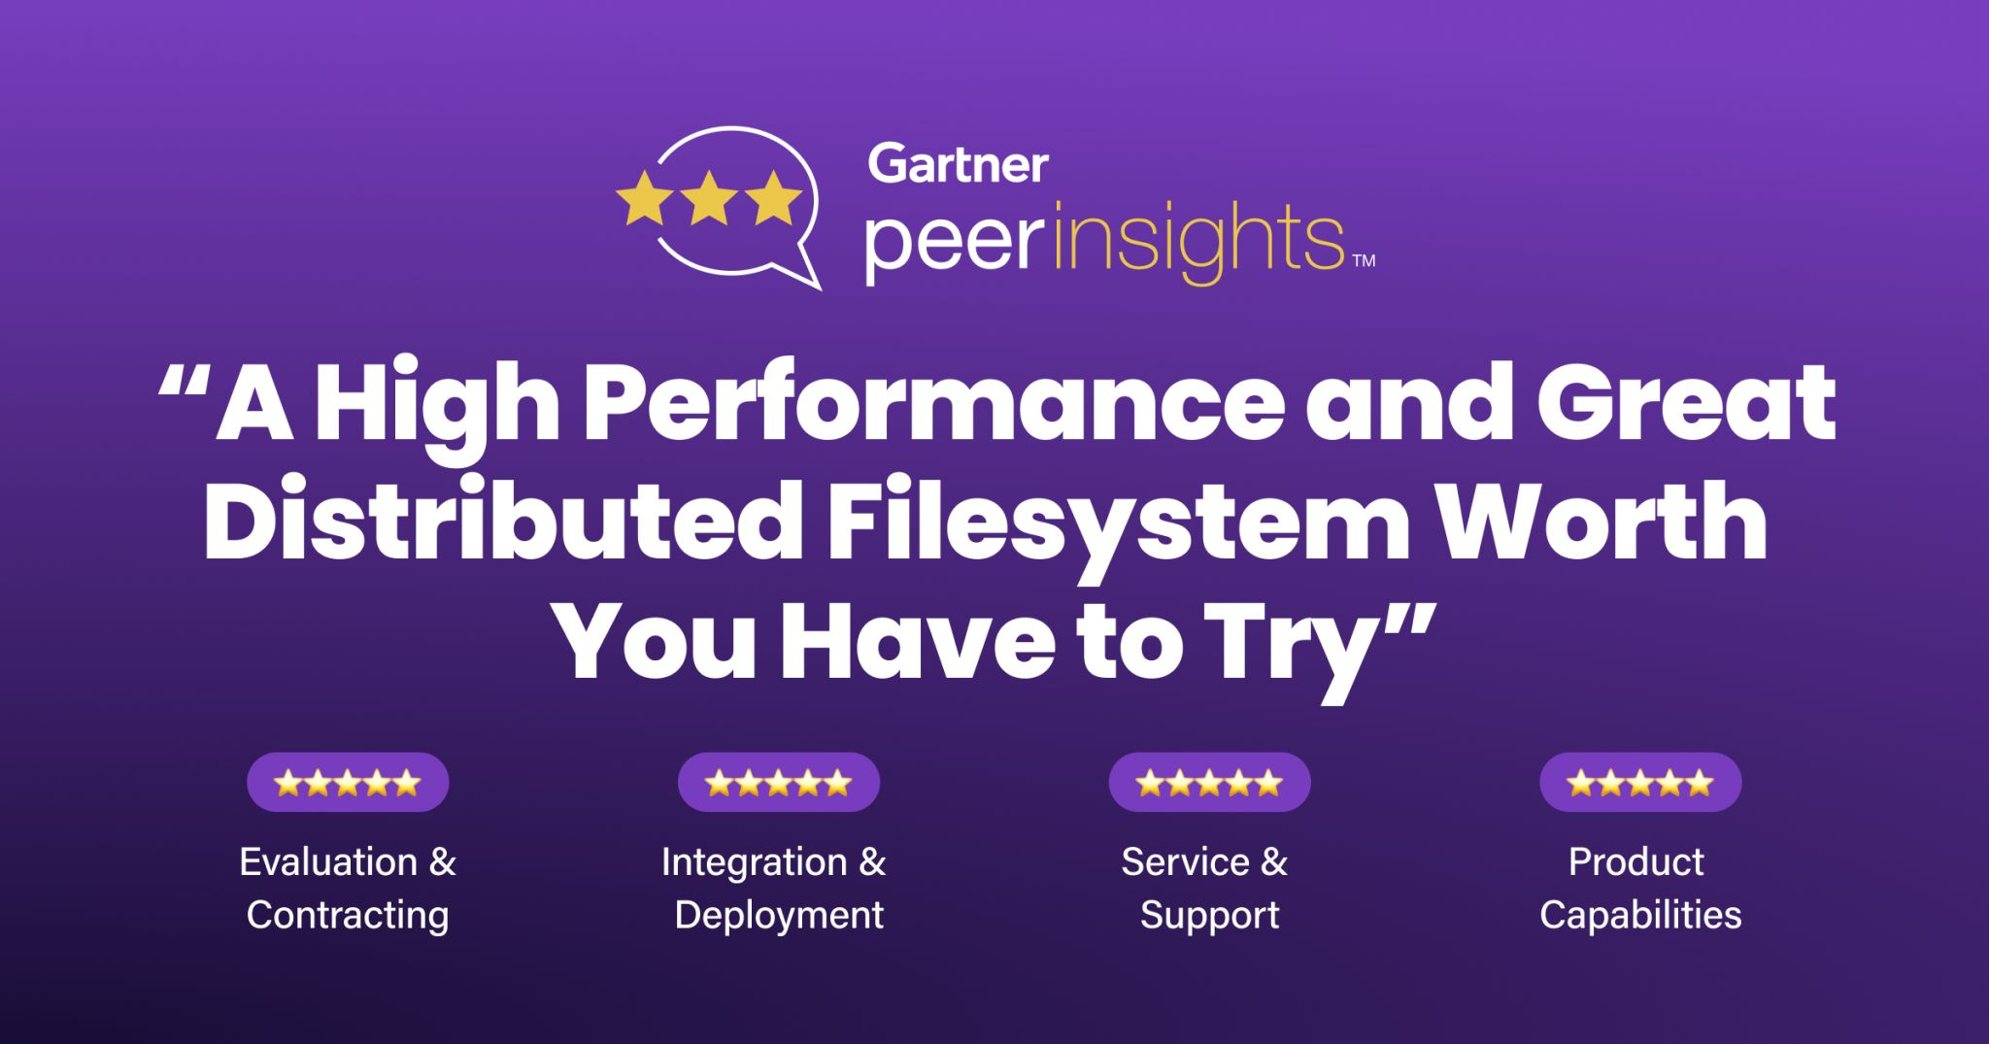
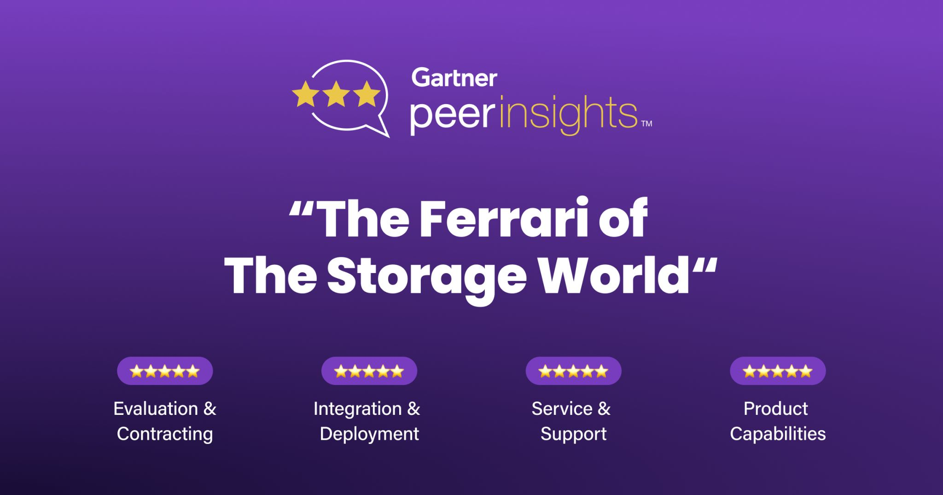
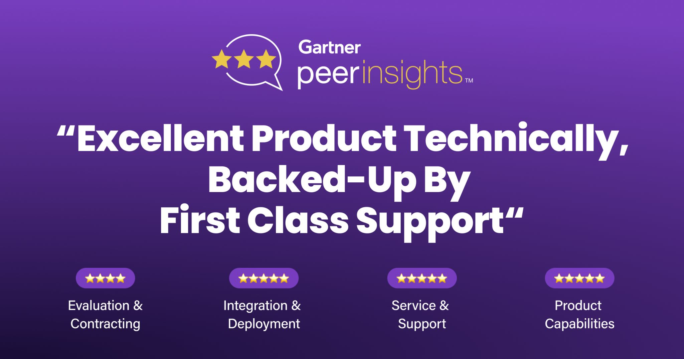
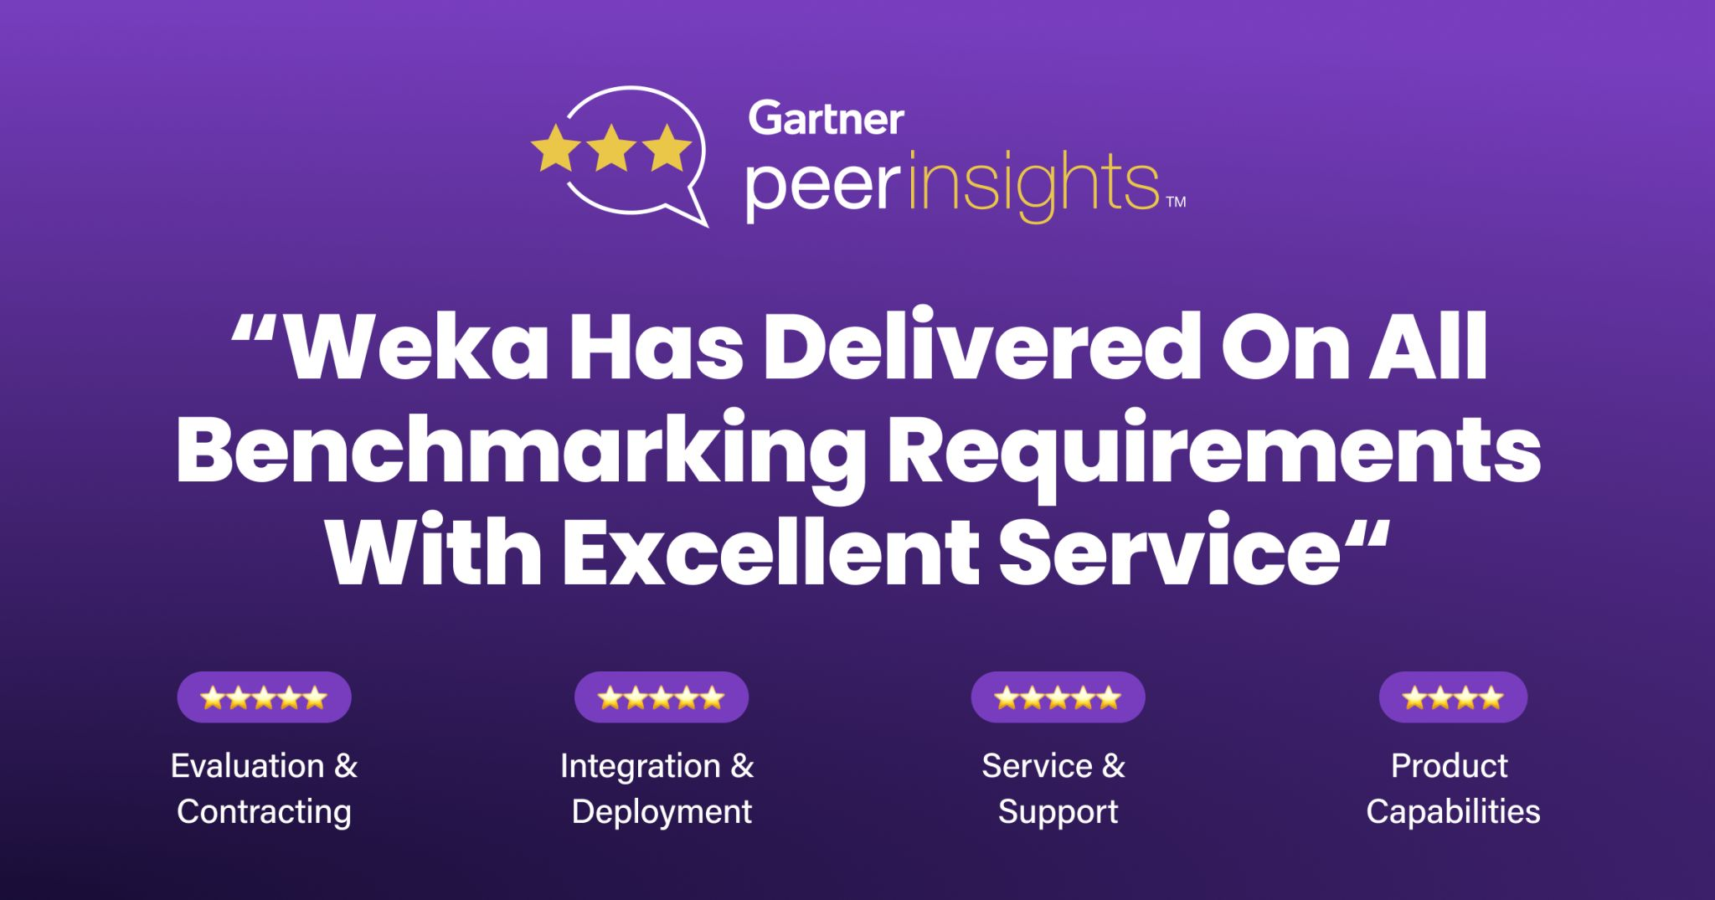
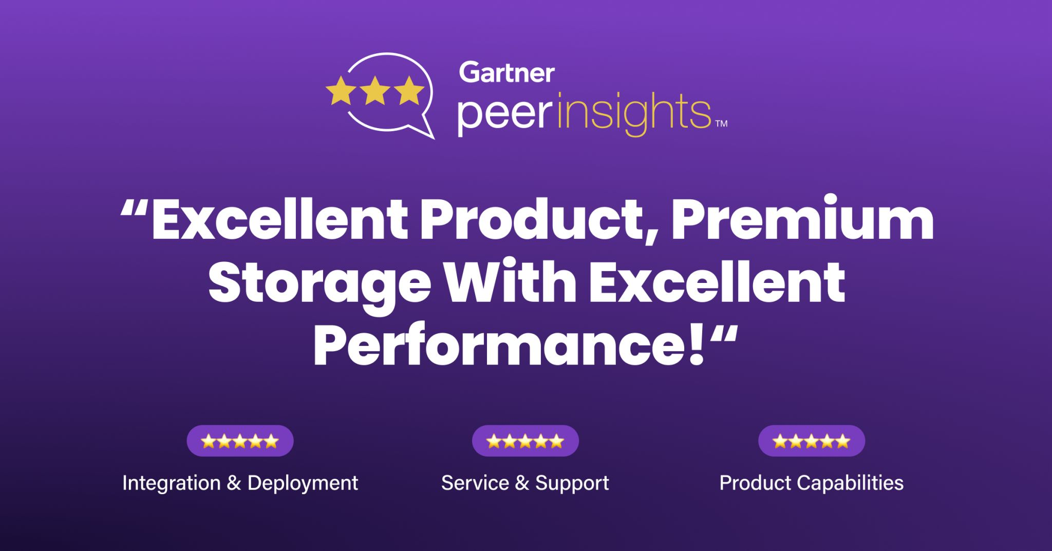
WEKA Reliability, Easy Management & Great Support
WEKA is the Top Ranked Distributed Filesystem at Gartner Peer Insights

Slide 15

derek@weka.io
+44 7949 595400
THANK YOU
chris@weka.io
+44 7970 834291

