Slide 1
Preserve, Protect & Defend Your Data at Scale with Spectra Logic
December 2025
David Taylor
11/12/25

Slide 2




Focused on Customer Success for 40+ years
Trusted
Helping organizations manage, migrate, store & preserve data from days to decades
Committed
Privately held & employee owned
More than 10,000 installations in 80+ countries
Global
Innovative
146 issued patents, 6 pending patents
Notes:
For over 45 years, Spectra Logic has pioneered data storage technology, evolving from a modest startup into a global powerhouse with solutions in over 10,000 installations across 80 countries.
As a privately-held, employee-owned entity, our close-knit culture prioritizes unparalleled service and innovation, a commitment demonstrated by our 142 data management and storage patents.
Trusted by some of the world's most data-sensitive organizations, we recognize data as more than mere information; it is society's genome, reflecting our shared past, present, and future.
Our dedication to sustainability and innovation ensures we handle this crucial resource carefully.
Now—Beyond the global reach of our solutions, what truly stands out is the positive impact on our customers. Today, we're excited to introduce a new wave of data management solutions tailored for the multi- and hybrid cloud-centric era.

Slide 3
Tape is Not Dead!
‘Rumors of my death were greatly exaggerated’
Mark Twain

Slide 4

Power of Tape Media
Extended longevity: preserve and protect data for multiple decades, from 15 to 30 years
Lowest TCO: most cost-effective storage option for data at scale with no unexpected fees to access data
High capacity: LTO and enterprise drives offer high storage capacities up to tens of terabytes per cartridge
Energy efficient: tape media consumes very little power when not in use compared to SSDs and HDDs
Portability and off-site storage: easily move or store tape cartridges off-site for disaster recovery and protection against cyber threats
Notes:
Tape technology has proven to be the cost leader in backup and archiving for years, and that is not changing anytime soon. With significant capacity advancements with every new tape generation, the cost per gigabyte of tape storage continues to decrease with each new technology upgrade, meaning even rapidly growing environments where data growth often outpaces budgets can harness the advantages of tape for backup and archive. Here are some significant reasons why you should consider implementing tape technology in your data storage environment for backup and archive:
Extended longevity: preserve and protect data for multiple decades
Tape is a long-term media by design. Disk and flash are not permanent and typically only last 3 – 5 years before they must be replaced.
The nature of tape is to preserve information indefinitely, 20 to 30 years. Libraries need to live as long as you expect your tapes to live
Lowest TCO: most cost-effective storage option for data at scale
Extreme scalability: enjoy high capacity, high performance or both
TeraPacks – highly efficient for loading tapes
Flexible & extensible: easy upgrades for investment protection
Ensures data sovereignty: data location is known and under your management
Ransomware resilient: air-gapped protection against cyber threats

Slide 5






















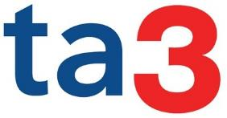














Serving the Largest Data Users in the World

Slide 6

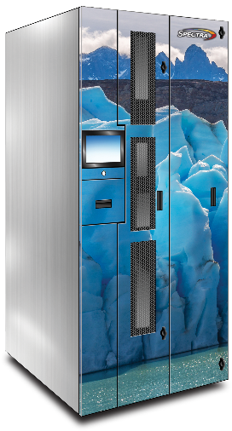

BlackPearl Software-Defined Hybrid Cloud Object Storage
Replication
Public cloud
Remote Object-Based Tape
BlackPearl
Object-Based Disk
Object-Based Tape
Applications
Data Backup
Data Archive
Digital Preservation
M&E
Medical records, video, etc.
Amazon S3
Amazon S3 Glacier
Spectra DS3
Object storage platform
Abstracts tape management complexity
Self-recovers from media, tape drive, disk & library errors
Integrates caching and replication to tape, disk & public cloud
Forward migrates to future media types & generations
Supports modern security protocols (such as AWS V4)

Slide 7




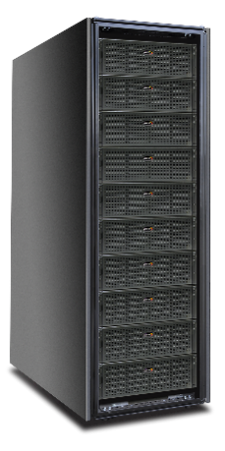
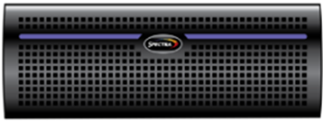
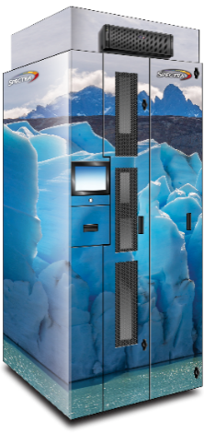
Spectra On-Premises Options Data Retrieval Costs | Data Tiering | Scalability
S3 Glacier Instant Retrieval
Millisecond retrieval from low-cost S3 storage class
S3 Glacier Flexible Retrieval
Minutes - 12-hour retrieval from lower-cost S3 archive class
S3 Glacier Deep Archive
12 - 48 hour retrieval from very low cost S3 deep archive class
Amazon S3 Glacier Storage classes
Expect costs for bandwidth and egress fees
Instant Access
Object-Based Disk
Millisecond retrieval of data from low-cost S3-compatible storage
Flexible Access Object-Based Tape
Minutes - hours retrieval
Scales to exabytes
Satisfies Flexible Retrieval & Deep Archive use cases
Modulate configurations based on selected tier
Dual copy
Spectra On-Prem Object-Based Disk & Tape
No unexpected or retrieval fees
Notes:
While public cloud storage offers perceived conveniences, it's important to consider the potential drawbacks, particularly when it comes to cost, performance, and security
S3 Glacier Instant Retrieval: Experience near-instantaneous data recovery, often within milliseconds, at a fraction of the cost of AWS S3.
Flexible Retrieval: Retrieve your data in minutes, significantly faster than the minutes-to-hours recovery time offered by AWS.
Deep Archive: Access your data in minutes to hours, outperforming AWS's hours-long retrieval times.
By choosing on-premise S3 and S3 Glacier storage, you can achieve optimal performance, cost-effectiveness, and security for your long-term data needs.

Slide 8
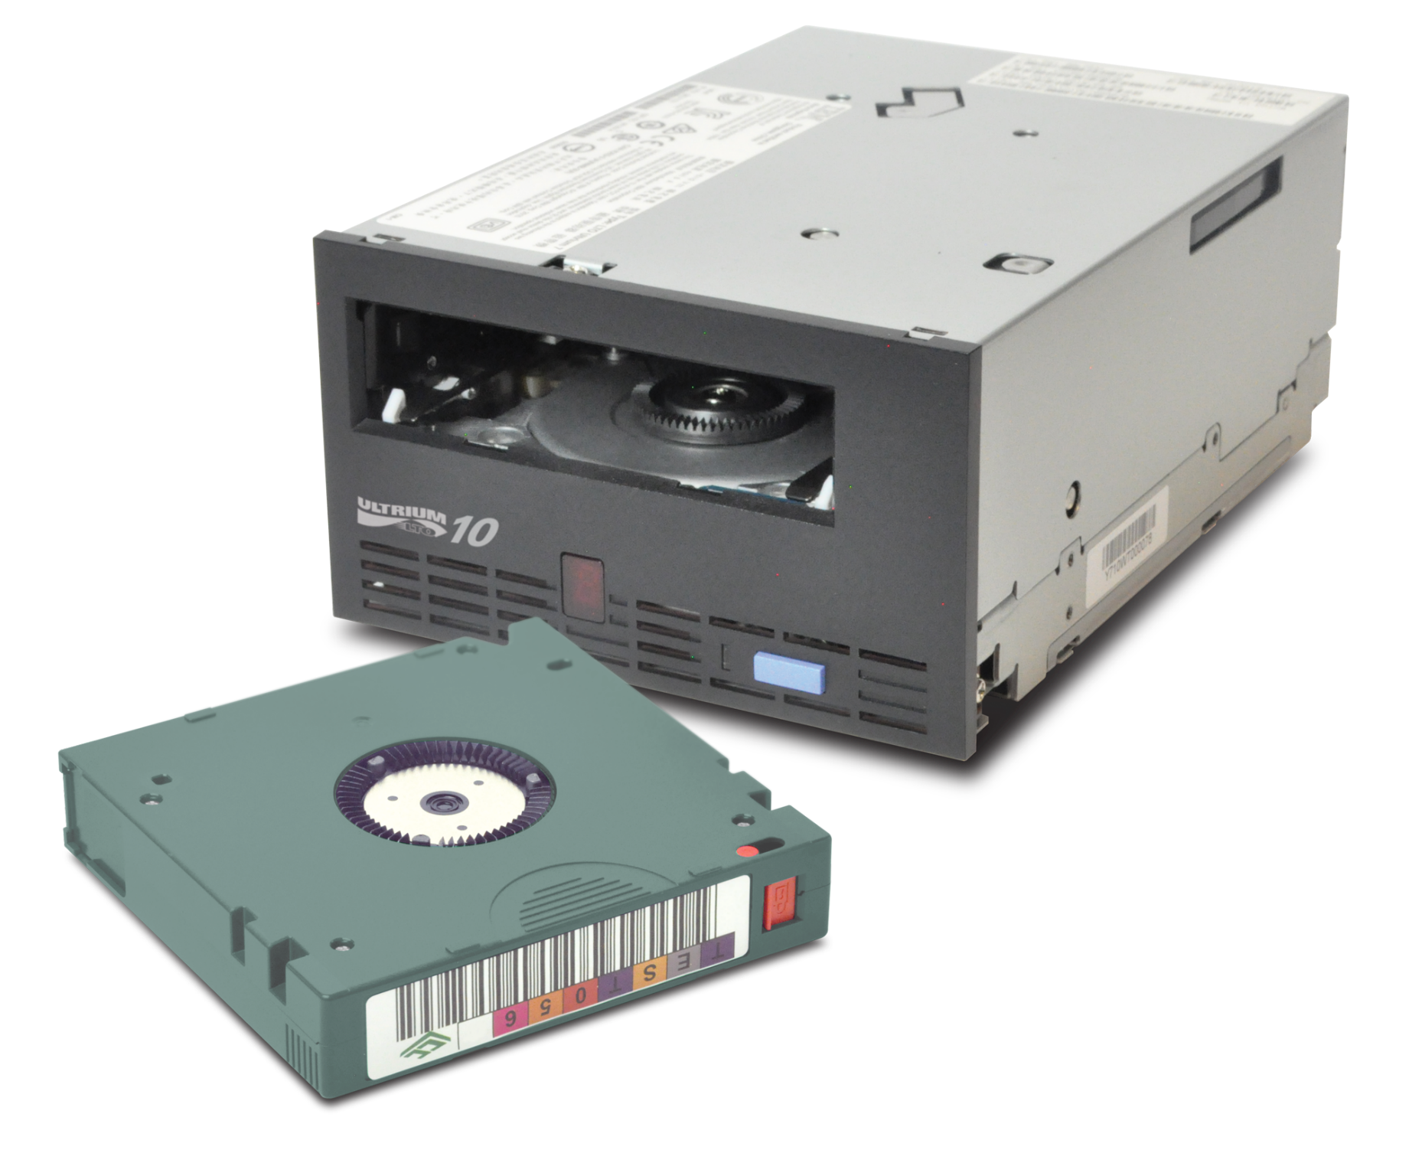
LTO-10
LTO-10 is Here
30 TB Uncompressed Capacity
400 MB/s Throughput
32G FC or 12G SAS Copper or Active Optical
New Strontium Ferrite Media
Entirely New Platform
Notes:
Marketing material – all datasheets and web are updated, webinar is available, marketing nurture campaign is underway

Slide 9
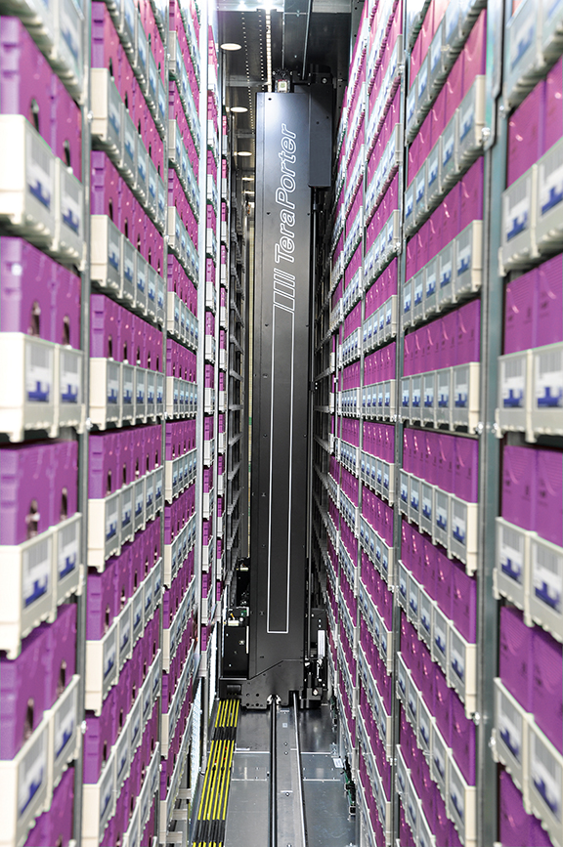
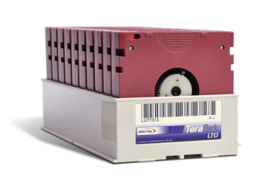
Streamline Operations with TeraPack Architecture
Optimal tape handling design
Minimize floor space with optimal data density with TeraPack® magazines
Increases overall robotic performance for faster operations
Efficient robotic operations improve reliability and maximize the life of the robotics
Efficient tape media handling
Expedite tape media installation, management and offsite storage
Easily import & export tapes through the front-panel TeraPack Access Port (TAP)
Non-disruptive tape handling as the library remains online
Notes:
Spectra tape libraries are designed to streamline operations with features like the TeraPack Architecture that allows efficient tape media handling and front-panel TeraPack Access Port (TAP) for non-disruptive import/export of tapes.
TeraPack Architecture: Spectra uses innovative “shelves” and TeraPack® magazines instead of traditional tape slots to store tape cartridges. This approach gives Spectra libraries the industry-best storage density, allowing you to store 10 LTO slots or 9 TS11XX in a TeraPack magazine. When paired with the high-performance transporter, the TeraPack magazine is not just a storage container but a vehicle for transporting multiple cartridges to drives, storage shelves, import, and export in a single robotic movement, reducing the time required to handle media by 90 percent.
Optimal tape handling design
Minimize floor space with optimal data density with TeraPack® magazines
Increases overall robotic performance for faster operations
Efficient robotic operations improve reliability and maximize the life of the robotics system
Efficient tape media handling
Expedite tape media installation, management and offsite storage
Easily import & export tapes through the front-panel TeraPack Access Port (TAP)
Non-disruptive tape handling as the library remains online

Slide 10
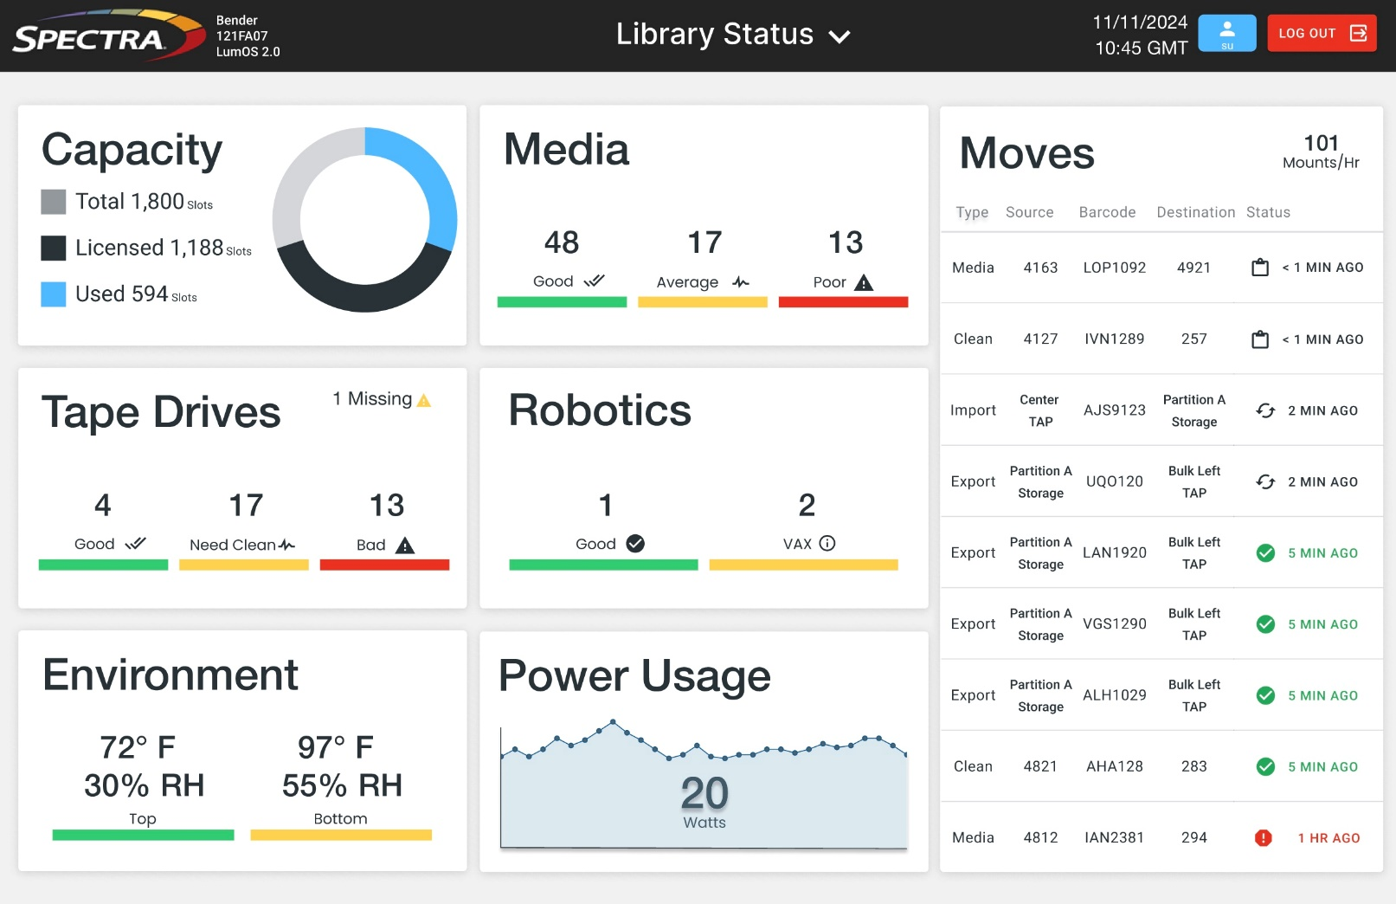
LumOS Library Management Software
Intuitive Graphical User Interface¹
Efficient management through touchscreen or remote devices
Easily automate repetitive tasks to save time
RESTful API to automate configuration, operation, monitoring and reporting tasks
Complete tasks faster and more efficiently
Supports multiple tasks through multi-threaded application
Keep library management software secure
Nessus Security scan to verify no vulnerabilities in every release
LumOS Library Management Software UI
1. LumOS library management software is available on Spectra Cube and TFinity Plus libraries. Refer to Library Management Software matrix for details.
Notes:
LumOS library management software is the advanced next-generation operating system for managing, monitoring, and controlling Spectra tape libraries. Based on a modern, extensible architecture that delivers greater functionality, reliability and as much as 20X the performance of the previous generation of library management software, LumOS software is a foundational platform designed to enable Spectra to continuously extend the functionality and longevity of TFinity Plus, T950, T680, T380, T200, and Spectra Cube libraries through future technology generations, into the next decade and beyond.

Slide 11
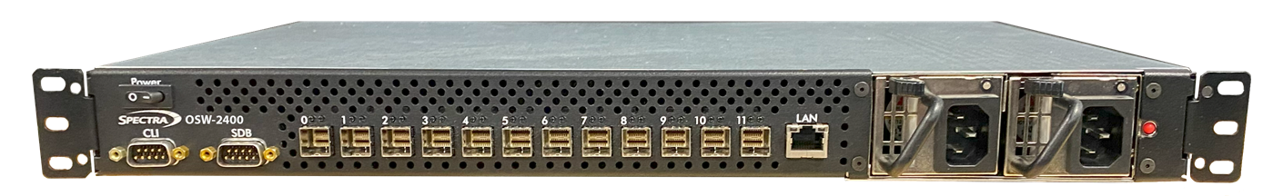
Spectra OSW-2400 Transforms Tape Connectivity
Industry’s only 24Gb/s Optical SAS-4 switch
Active Optical Cables (AOC) – up to 100m
Copper cables – up to 3m
Reduces or eliminates FC dependency
Lowest per-port cost vs. FC & Ethernet
Up to 70% less cost than Fibre Channel
Extends and maximizes tape library investment
Modernizes and standardizes tape connectivity
Storage admins can manage without special skills
Maximizes flexibility, enables switched topologies
Resource sharing | performance aggregation | HA
Supports all Spectra tape libraries
Spectra OSW-2400 Optical SAS Switch
Notes:
Spectra® OSW-2400 Optical SAS Switch is the industry’s first 24G SAS-4 switch utilizing active optical cables that extend connection distances up to 100 meters.
This innovative solution reduces or eliminates the need for Fibre Channel HBAs, switches, and cables while enabling switched topologies within data center environments—all without requiring specialized storage networking skills. The OSW-2400 switch lowers per-port costs to 1/3 of Fibre Channel while maintaining performance, scalability, and security. This allows organizations to streamline tape connectivity, enhance operational flexibility, and minimize infrastructure costs.

Slide 12

Defending Your Data
Air-gap storage
Prevents unauthorized access, cyber threats, and malware from compromising backup copies
Off-site copy
Provides data availability and recoverability for disaster recovery
Write Once Read Many (WORM)
Delivers data immutability for compliance and data integrity
Standard encryption
Built-in AES 256-bit encryption
Security Key Lifecycle Manager (SKLM)
Additional layer for the highest standard of encryption security¹
1. Available in Spectra TFinity, T950, and Cube libraries.
Notes:
Modern object-based tape storage is particularly well-suited to complement backup solutions. By combining the flexibility of object storage with the security of tape technology, object-based tape solutions offer several advanced data protection capabilities, including:
Air-Gapped Storage: Because tape cartridges are online only when the tape cartridge is mounted on the drive, tape technology’s inherent offline nature creates a “tape air gap,” an electronically disconnected or isolated copy of data that prevents threat actors from hacking, encrypting, or deleting data. An air gap is critical because it separates the golden copy of data and potentially corrupted data in primary storage or another system within the backup infrastructure.
Immutable Snapshots and Object Lock: Object storage solutions with immutable snapshots and object lock capabilities provide additional protection against ransomware. Immutable snapshots ensure that previous versions of data remain intact and can be restored in the event of an attack. In addition, object lock ensures that data cannot be rewritten or modified.
Off-Site Copy: The protection offered by air-gapped tape storage can be extended with an off-site copy of data. A second copy of data on tape that can be ejected and stored at a different location is a truly unbreachable way to meet best practices for data protection.
Standard encryption: Built-in AES 256-bit encryption
Security Key Lifecycle Manager (SKLM): Additional layer for the highest standard of encryption security¹

Slide 13
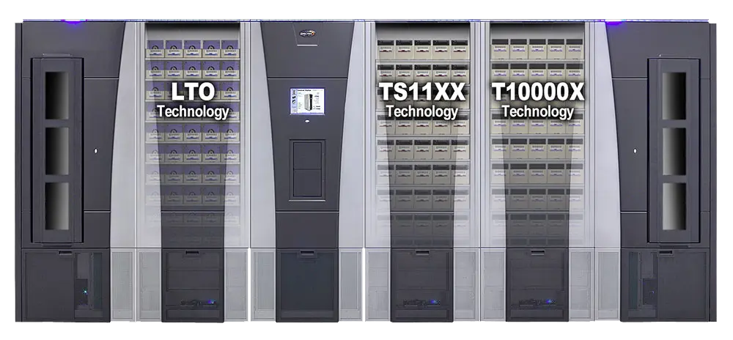
Tri-Media Tape Support
Supports multiple tape technologies¹
Integrates LTO, IBM TS11XX, and Oracle T10000 in a single library
Flexible data management
Allows easy coexistence of different tape types for streamlined operations
Preserves legacy investments
Enables continued use of Oracle T10000 media
Efficient resource utilization
Simplifies tape import and management without needing separate systems
Seamless transition across technologies
Enables smooth integration and coexistence of tape generations for long-term efficiency
TFinity tape library with tri-media support
Notes:
Spectra Logic TFinity tape libraries stand out with their unique tri-media support, offering the flexibility to integrate and manage LTO, IBM TS11XX, and Oracle T10000 tape technologies within a single system. This capability is especially valuable for organizations dealing with large-scale archives and facing challenges with the cost and complexity of supporting older tape technologies. By supporting multiple tape types, TFinity libraries allow seamless data migration and offer a safeguard for legacy media, including Oracle T10000. This ensures users can continue accessing and transferring their data across generations and drive technologies while minimizing disruption and preserving their hardware investment.

Slide 14
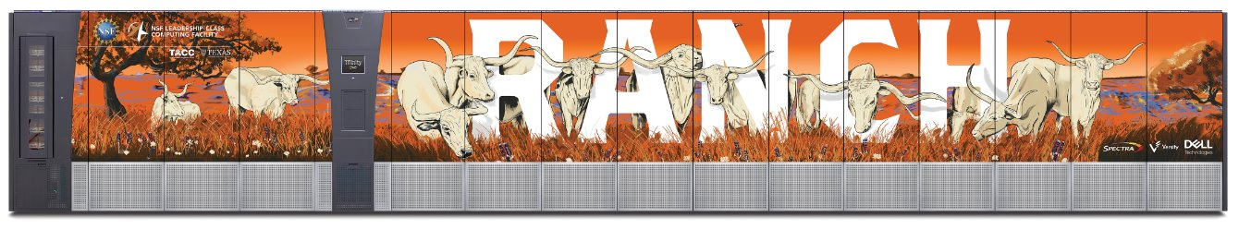
TACC 1EXB of Storage
AI Research
Versity Software as the data mover
2x 15 Frame Libraries
20x LTO-9 Drives

Slide 15
Thank You
www.spectralogic.com

