Slide 1
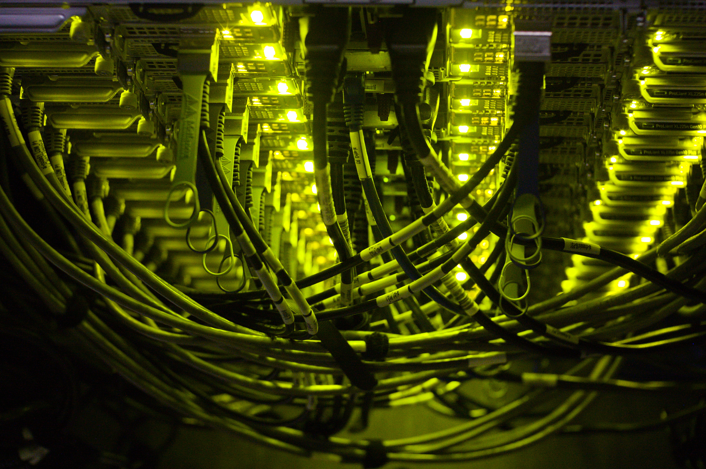
Arm – nvidia devkit nodes
4 ARM cpu – dual Nvidia GPU/Nvidia DPU nodes available
Currently underused.
Available to Dirac and local users wishing to test/optimize/benchmark codes on ARM CPU+nvidia GPU.
Request access via SAFE.

Slide 2
Node specifications
4 GPU nodes
  Single Ampere Altra processor – 80 cores
  512 GB memory
  2 x NVidia A100-40 GPUs
  2 x Nvidia Bluefield-2 DPUs (HDR)
  4 TiB NFS shared NVMe storage (40TiB parallel fs in new year).

Slide 3
Software
Rocky 8
Basic gnu toolchain installed
Nvhpcx/cuda 11+12 installed
Can run containers via singularity/apptainer
Access to nodes from x86-64 login node via SLURM.

Slide 4
Request Access
Via SAFE
Request access to project cl01..cl04
~1 week to grant access and send link to docs.
Uses the same MFA/password as DIaL2/DIaL3.

Slide 5
Contacts
cjm14@leicester.ac.uk
leicester.support@dirac.ac.uk

