Slide 1
VAST Data
Aligning data infrastructure to meet new demands for AI research and investment.
Vas Kapsalis
Doug Hadfield

Slide 2
Unlock Real World Data For AI Computing
VAST is pioneering new outcomes by breaking infrastructure tradeoffs at every level
Simplicity
Scratch
Enterprise Storage
User space /
Research Data
Temporary Data
Transaction Processing
Traditional Parallel FS
Scratch /Checkpoints
Value In A
Single Event
Deep Learning & Machine Learning
Value In The
Data In Aggregate
Speed and scale
Data Age

Slide 3
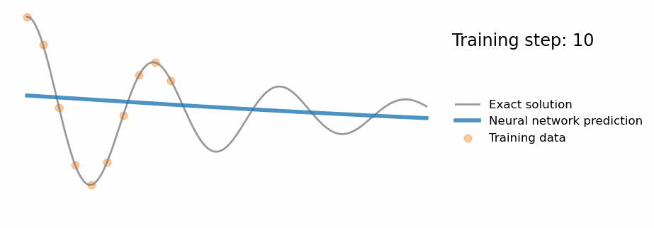
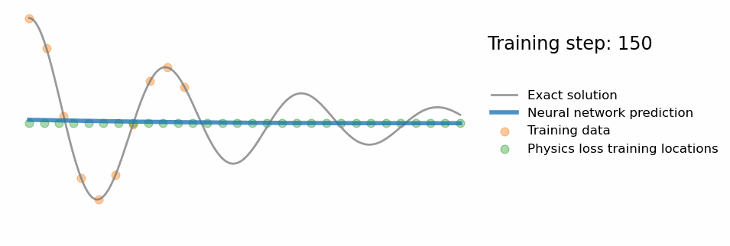
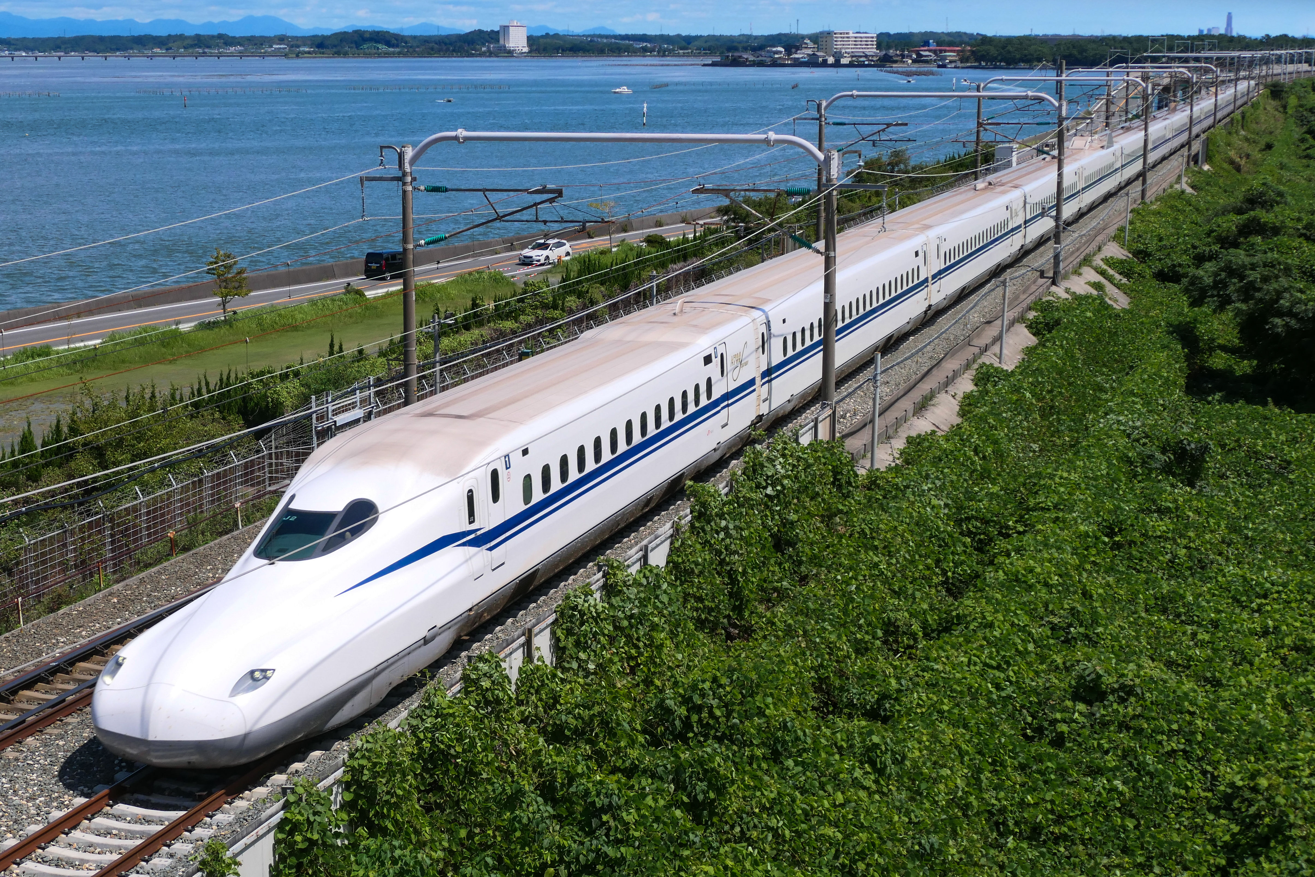
Physics Informed Neural Networks
Reducing compute consumption for well behaved models using surrogate lookups or providing a way to predict real world outcomes (though retain caution)
Model Data
Sensor Data

Slide 4



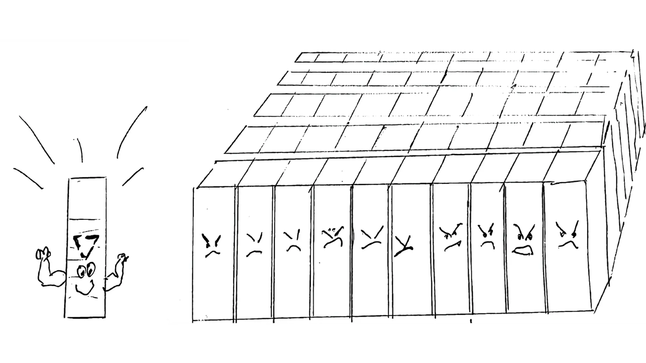

TACC as selected VAST as the data platform for Stampede3.
A particular nuclear code had only scaled to 350 nodes using a parallel filesystem before the metadata system failed.
VAST scaled to 4,000 nodes before the customer stopped testing
20U of VAST was able to support 50 racks of servers.
No downtime during an upgrade

Slide 5
Introducing A New Hyperscale Architecture
Disaggregated, Shared-Everything (DASE)
Stateless Containers
Stateless Containers
Stateless Containers
Stateless Containers
Data Center-Scale NVMe Fabric
SCM + Hyperscale Flash
SCM + Hyperscale Flash
SCM + Hyperscale Flash
SCM + Hyperscale Flash
Exabyte Scale Global Namespace
“The Architecture Of The Future” - IDC
Disaggregated
Stateless Nodes Are Composable,
Data Always Redundant
Shared-everything
No Need For Cache Coherence,
Massively Scalable Data Services
Radically Efficient
New Global Efficiency Codes To Revolutionize NVMe Economics

Slide 6
The VAST Data Platform
All of Your Data, from Edge-to-Cloud. Enriched, Fused & AI-Ready
S3, S3A
NFS, SMB
GPUDirectTM
Pushdown
Pushdown
VAST-DB REST API
CSI, Helm
Manilla
NVMe/TCP
Unstructured & AI Data APIs
Semi-Structured Data APIs
Structured Data APIs
Volume Store APIs
Unified Security: Multi-Tenant & Cloud-Scale
VAST Data Store: Multi-Protocol Datastore
VAST Data Base: Analytical & Transactional
Uplink
Cloud-Based
Fleet Management
VAST Global Namespace: Edge-to-Cloud
Public
Cloud
Private Cloud &
Edge Data Centers

Slide 7


Thank You
Doug Hadfield
doug.hadfield@vastdata.com
Vasilis Kapsalis
vasilis.kapsalis@vastdata.com
+44-7767-477367
https://vastdata.com/whitepaper
VAST Data

