Slide 1
DiRAC 3 Phase 2
Biagio Lucini
On behalf of the DiRAC Technical Directorate

Slide 2
The system upgrade process
Science objectives
Technical requirements
Engagement with partners
Procurement, deployment and commissioning
Science Board
Technical Directorate
Ad-hoc committees

Slide 3
The Technical Directorate
Established in 2020
Membership: Co-chairs; Director of Innovation & Technology; 1-3 additional DiRAC community experts
Current members: Alastair Basden, Antonin Portelli, Jeremy Yates, Kieran Leach, Biagio Lucini
Relevant duties
Develop the technical case for DiRAC
Approve procurement plans
Oversee the smooth running of the facilities
Discuss future directions in software and hardware (including strategic partnerships)

Slide 4
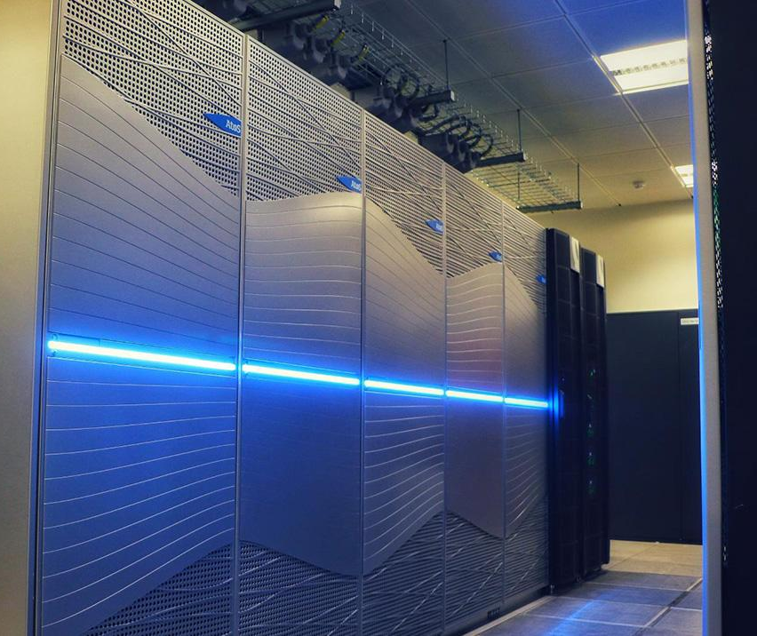
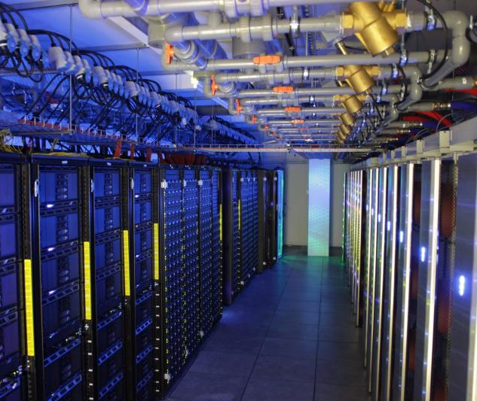
DiRAC 3 Phase 1 (and before) systems

Slide 5
Timeline
Nov. 2022
Strategic decision to upgrade TURSA @ Edinburgh and the Memory Intensive System @Durham
2022–2023
Design and deployment
Summer /Early fall 2023
Commissioning
Currently
Production

Slide 6
Extending access to DiRAC services (Credits: M. Wilkinson)
Recently deployed additional hardware at two sites:
Edinburgh – Extreme Scaling Service – 256 additional A100-80GB GPUs
Durham – Memory Intensive Service – 168 nodes (21.5k cores) of AMD Milan CPUs
Between Oct 2023 and Mar 2024:
50% of new hardware allocated via Director’s Discretionary Call for DiRAC projects
400k GPU hours and 40M CPU core hours were allocated
Call was 2x over-subscribed
50% being made available to non-STFC groups:
CompBioMed consortium
HECBioSim and CCPBioSim consortia
PAX ExCALIBUR project (materials modelling)
MRC-University of Glasgow centre for virus research
UCL Centre for AI
UKAEA
Goal of non-STFC allocations: Offer sufficient resource allocation to allow production-scale calculations which would otherwise not be possible on a UK service
Explicit effort on the DiRAC side and within consortia, to inform a future cost model
Notes:
Also avoid demonising HPC
Energy-optimal GPU frequency limits solving an ε-constraint on performances, i.e. the GPU frequency that consumes the less energy while tolerating a maximum reduction of ε in performances relatively to the maximum frequency setting.

Slide 7
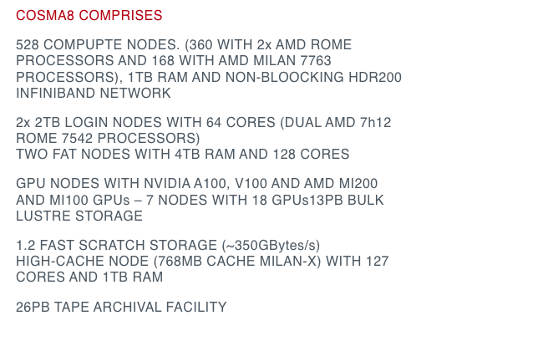
COSMA 8 current status
Additional capabilities include
168 nodes and 6 PB of Lustre storage
Ability to run 512 node jobs on 64k cores

Slide 8
TURSA current status
Additional capabilities include
64 nodes with a total of 256 A100-80 GPUs
1.5 PB of Lustre storage

Slide 9
Key takeaway messages
The hardware follows the science goals
The strategy is always proactive, never reactive
Performance is always measured by user codes
The user community plays a central role in defining the strategy
The approach is anticipated to stay in place for future opportunities
The approach is open and cooperative

