Slide 1


Convergence of HPC and AI workloads with HPE Smartsim
Nick Southorn – HPC & AI Solution Architect
December 2023

Slide 2

About SMARTSIM
  Open-source library bridges the divide between traditional numerical simulation and data science
Overcomes the technical hurdle of transferring data between simulation and data science engines
  Enables simulations to be used as engines within a system, to add value and enable new applications
Orchestrator
Native C/C++/Fortran simulation
Interactive or Automated
AI Models
AI Models
SmartRedis Client API
SmartRedis Client API
Analysis and Visualization
Data Sources
Code / Scripts
PYTORCH | TENSORFLOW | ONNX
Notes:
Elevator pitch slide: what is SmartSim?
Break down the technical barriers between existing simulations and modern data science techniques including ML, statistical analysis/data transformation, and visualization
Compare/contrast – difficult to integrate Python code into existing simulations:
Typical way: wait for simulation to finish, dump results to disk, load in to ML model
SmartSim way, keep in memory through Orchestrator, access data directly and send updates straight back to simulation

Slide 3
HPC Application Domain Examples
  Fluid Dynamics: Ansys Fluent, OpenFOAM, SU2
  Ocean: MOM6, MIT-GCM
  Atmosphere: CAM, SPCAM
  Chemistry: QMCPACK, GAMESS
  Coupled Climate: E3SM, CESM
  General Multi-Physics: MOOSE
  Molecular Dynamics: LAMMPS, OpenMM, CP2K,
  Biology: NAMD
  Quantum Chromodynamics: CHROMA, MILC
  Easy to instrument an existing codebases to enable new AI/ML/data science applications
  Very little new code needs to be added
Notes:
Q) Which of these have we tested on?
Briefly mention names
Many of these types of simulations boil down to similar calculations and approximations of fundamental physics.

Slide 4
High Level architecture

Slide 5


The Database
SmartSim currently uses Redis (or KeyDB) as in-memory Key-Value Store (Database)
Redis was chosen mainly for three reasons:
  Stability: very difficult to take shards down, possibility of redundancy
  Performance: in our benchmarks, Redis performs reasonably well, KeyDB offers a boost
  Modularity: modules such as RedisAI make it flexible and give the possibility of expanding its functionalities
Redis can be clustered (i.e., several shards act as a single distributed DB)
  We implemented our client so that no unneeded data movement needs to occur
SmartSim offers two ways of deploying Redis within a workflow
  Clustered (on a separate set of nodes)
  Co-located (on the same nodes where the application is running)

Slide 6

Uses of smartsim

Slide 7
Smartsim enables AI-enhanced simulations
Lower the barriers to entry
Enable Fortran, C, C++ simulations to interact with ML packages efficiently
Rapidly prototype and iterate with new ML models
Allow scientists to focus on building applications not code or infrastructure
Introduce a new workflow paradigm
Simulations as producers and consumers of data and ML models
Data is kept in-memory and available in-flight
GOAL: Enable new tools for scientific discovery using ML methods and scientific simulations
Capability/Outcome
Partial Model Emulation
Online Inference
Client
SmartSim
Simulation
Online Training
Online Analysis
Computational Steering
Notes:
New capabilities that SmartSim provides:
. Partial Model Emulation: replacing part of a numerical solver with an ML model
. Online Inference: reintegrating ML model output into a simulation
. Computational Steering: influence simulation as it proceeds, modifying state of the simulation to push for a condition, such as applying a Kalman filter or simulation nudging
. Online Analysis: real-time access to model output for solution fitness and processing model output so that it can be pipelined to other components.
Enables monitoring of experiment baseline metrics and termination of experiment if those metrics are violated
. Interactive Visualization: real-time viewing of the output of a model, allowing inspection of the model solution by engineers and scientists. Simple integration with visualization engines such as ParaView.

Slide 8






Online Visualization and analysis
User Story: I want to perform visualization and analysis while my simulation is running
Stream data from C/C++/Fortran simulations for analysis, and visualization in real time.
No reading/writing to slow shared filesystems
SmartRedis Python Client sends/gets Tensors as NumPy arrays
Tensors
(e.g., Fortran Arrays)
Rank 1
Shard 1
SmartRedis
.
Scripts
.
Data
On-demand interactive
workflows
.
.
.
.
Rank n
.
SmartRedis
MPI + X (C/C++/Fortran) Simulation
Shard n
Data
Scripts
“Orchestrator”
Datastore and scripting engine
Notes:
Clustered model.
MPI sim application → orchestrator ← JPN/Paraview
Streaming data analytics
Easily convert data between languages
Easy to implement in all languages, simple
lightweight client library

Slide 9


Online Training
User Story: I want to create machine learning models on simulation data without managing 10+GB files
SmartRedis Client can be used inside DataLoaders for TensorFlow and PyTorch to perform Stream Training
Trained models can be checkpointed, saved and later sent to the database for online inference.
Can be set from any language and called from any language e.g., model set from Python, called from Fortran
Training Service
Training Service
Tensors
(e.g.., Fortran Arrays)
Shard 1
Trained Models
(serialized)
Rank 1
SmartRedis
.
Data
AI Models
.
.
.
.
.
.
Rank n
SmartRedis
Tensors
(NumPy Arrays)
MPI + X (C/C++/Fortran) Simulation
Shard n
Data
AI Models
Horovod/DL Plugin
Notes:
Create training jobs that consume data directly from HPC simulations.
Use distributed frameowrks like horovod and DL plugin. when
launched from smartsim, they immediately connect the SmartRedis
data loader to the Orchestrator database
Checkpoint and store models within the database for immediate use
Inside simulations or HPC workloads.
SmartSim can also create and launch ensembles for dataset creation
That spans parameter spaces by writing into configuration files or passing
Executable arguments.
Trained model could be used by another application

Slide 10
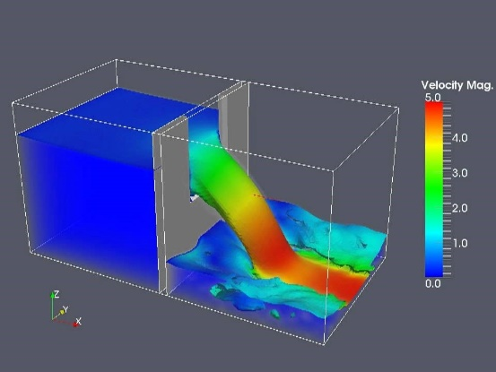

ML for turbulence prediction in CFD (OpenFOAM)
User story: I want to use a machine-learning model to reduce my time-to-solution
TensorFlow model provides a pre-conditioned state that reduces number of solver iterations
Multi-stage workflow in one Python script
  Mesh decomposition
  ML training
  ML inference
  Solver Integration
  Analysis
  Visualization
Tensors
(i.e., Fortran Arrays)
Shard 1
.
Data
AI Models
SmartRedis
.
.
.
Shard n
OpenFOAM Simulation
Data
AI Models
Legend
ML inference results to simulation
“Orchestrator”
Datastore and inference engine
Data to Orchestrator
  Code repo: https://github.com/CrayLabs/smartsim-openFOAM
Notes:
Orchestrator can store, tensors, data (strings), functions, ML models
Online inference is the primary capability of smartsim
Models in PT, TF, and ONNX( scikit-learn, spark, and others)
can be written in Python and called from Fortran or any of the
client languages
The python code executes in a C runtime without the python
interpreter
calls are distributed evenly amoung all shards of the database
cluster (possibly utilizing GPU nodes for computation) because
of direct addressing by the clients.
the code example shows a serial example of how to use Smartsim
to spin up a database locally (either laptop or single node) and store,
execute, and retrieve the result of a simple PyTorch Conv net

Slide 11

Running at scale

Slide 12


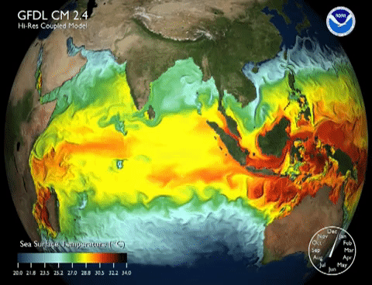
Collaboration example
Goal: Improve the turbulence model using ML
MOM6+PyTorch orchestrated via SmartSim
12 ensemble members
228 CPU nodes - 10,920 Cores
16 GPU (P100) nodes – 16 GPUs
970 billion inferences over 10 simulation years
1.6 million inferences per second
With SmartSim, the accuracy of the EKE over the current state of the art improved by over 20%
Notes:
We demonstrate the first climate-scale, numerical ocean simulations improved through distributed, online inference of Deep Neural Networks (DNN) using SmartSim.
The paper details the SmartSim architecture and provides benchmarks including online inference with a shared ML model, EKE-ResNet, on heterogeneous HPC systems.
The simulation runs a 12-member ensemble of global-scale, high-resolution ocean simulations, each spanning 19 compute nodes, all communicating with the same ML architecture at each simulation timestep.
In total, 970 billion inferences are collectively served by running the ensemble for a total of 120 simulated years.
The inferences are used to predict the oceanic eddy kinetic energy (EKE), which is a variable that is used to tune different turbulence closures in the model and thus directly affects the simulation.
The root-mean-square of the error in EKE (as compared to an eddy-resolving simulation) is 20% lower when using the ML-prediction than the previous state of the art.
This demonstration is an example of how machine learning methods can be integrated into traditional numerical simulations, replace prognostic equations, and preserve overall simulation stability without significantly affecting the time to solution.

Slide 13

SmartSim HLRS updates
SmartSim available as a module on HLRS Hawk
New SmartSim Spack install enables support for multiple accelerators (Nvidia & AMD) and expedites installation of SmartSim updates on HPC systems
Recent SmartSim collaborations and use cases include:
  Relexi: A reinforcement learning solution for computational fluid dynamics built using SmartSim and run on HLRS Hawk
    In-situ trained and validated turbulence model surrogates
    Policy creation for active flow control systems
  OpenFOAM Data Driven Modelling Special Interest Group
    Formal adoption as an OpenFOAM module targeted for Oct. 2023
    OpenFOAM use cases include in-situ training and inference with a neural network and optimization of OpenFOAM ensembles
  M²LInES - Multiscale Machine Learning In Coupled Earth System Modeling
    Recently deployed in-situ CNN inference in MOM6 on Frontier (672 compute nodes: ~20,000 CPUs, ~5000 AMD GPUs)
  Adoption into U.S. Department of Energy ExaWorks SDK for exascale workflows targeted for 2023
Ocean simulation on Frontier with embedded CNN inference using SmartSim

Slide 14

Call to action
Please think about where you could use SmartSim in your research
Contact me if you want to know more
Workshops
Collaboration and co-authoring
Spread the word!
Notes:
SmartSim allows to run mixed workflows on supercomputers:
Connecting simulations and AI
Connecting visualization
The modular design makes it easy to customize the workflow
The lightweight client has only few dependencies and is never an obstacle to application build processes

Slide 15
Thank you
nicks@hpe.com

Slide 16

LINKS
Other SmartSim Information
  Contact: CrayLabs@hpe.com
  SmartSim Repository: https://github.com/CrayLabs/SmartSim (Includes docker container with tutorials!)
  SmartRedis Repository: https://github.com/CrayLabs/SmartRedis
  Seminar given at NCAR: https://www.youtube.com/watch?v=2e-5j427AS0
  SmartSim Case studies: https://github.com/CrayLabs/SmartSim-Zoo
  SmartSim Slack workspace (link on repo)
Links to the three publications with their respective focus areas:
  HPC & AI: https://www.sciencedirect.com/science/article/pii/S1877750322002435
  CFD: https://www.sciencedirect.com/science/article/abs/pii/S0142727X2200162X?via%3Dihub
  Framework description: https://www.softwareimpacts.com/article/S2665-9638(22)00106-3/fulltext
  Code for Paper (including data preparation and visualization): https://doi.org/10.1016/j.jocs.2022.101707
  https://github.com/CrayLabs/NCAR_ML_EKE
  Models and Datasets for Paper: https://zenodo.org/record/4682270#.YMkM525lDUJ
  Seminar given at NCAR: https://www.youtube.com/watch?v=2e-5j427AS0
Notes:
features will be explained in a few slides
Andrew will provide frotran code example

