Slide 1

Making a Case for Sufficiency
Cross-case study lessons
Carolynne Lord
Senior Digital Sociologist
Digital Research

Slide 2
      ARINZRIT
Cross institutional interviews with users and providers of scientific infrastructures
      DRI Futures
Workshops, interviews and surveys with UKCEH staff about FAIR, collaborative science and sustainability
      SDRI
Environmental science case studies (monitoring, modelling, and infrastructure): interviews, workshops, futuring, data science
      Soil Sufficiency
Case study of physical and digital soil data using interviews, archive tours, and workshops with UKCEH data stakeholders

Slide 3

The Paradox of Efficiency
      A focus on efficiency and optimisation
      Cheaper, faster, and more capacious systems = increased used
      Near doubling of jobs
      How can we hold patterns of demand still?

Slide 4

Waste in Use and Provision
ARINZRIT
Researchers don’t have time – they are limited by deadlines, and the publish and perish paradigm
An increase in ‘junk’ science
Stakeholders (e.g., reviewers, funders) expect more compute
Little oversight on this – there are sustainable travel policies, but few sustainable DRI policies
Policy can limit the use of shared infrastructures, or encourage fast turnaround in hardware lifetimes
Source
Lord et al. (2025). ‘The World is Not Enough: Growing waste in HPC-enabled academic practice’. Proceedings of the 2025 CHI Conference on Human Factors in Computing Systems.

Slide 5
Moving Beyond Efficiency
DRI Futures
Trade offs between locally vs. working in the cloud? [I] want to know
End of life – disposal of HPC
Good practice sharing
What is just enough impact for a science output?
Sharing best practices
FAQ of choices to have knowledge to choose the lowest impact one
Current rule of data – keep everything until you leave
Leaving individual nodes in – energy costs
Should we be using a lot of data?
Trade-offs – efficiency vs. carbon emissions
Data storage vs. model runtime
Sharing contextual knowledge and awareness

Slide 6
Sufficiency
      The use and provision of ‘enough’
      Policies for less, lighter, slower (Iten et al., 2024)
      Sufficiency + efficiency as important partners
Source
Iten et al. (2024) ‘Sufficiency policy: A definition, conceptual framework, and application to municipalities’, Sustainability Science 19.5: 1709-1734.

Slide 7
Sufficiency: A Typology
DRI Futures
      Absolute Reductions
Reduce the amount of consumption
      Modal Shifts
Change the technology or infrastructure of consumption or provision
      Product Longevity
Prolong the lifetime of hardware or software
      Sharing Practices
Encourage sharing among users and communities
Source
  Sandberg, M. (2021). ‘Sufficiency transitions: A review of consumption changes for environmental sustainability’. Journal of Cleaner Production. 293 (15): 126097.

Slide 8
Moving Beyond Efficiency
DRI Futures
Absolute Reductions
Modal Shifts
Product Longevity
Sharing Practices
Should we be using a lot of data?
Trade offs between locally vs. working in the cloud – want to know
End of life – disposal of HPC
Good practice sharing
Current rule of data – keep everything until you leave
Data storage vs. model runtime
Leaving individual nodes in – energy costs
Sharing best practices
What is just enough impact for a science output?
FAQ of choices to have knowledge to choose the lowest impact one
Trade-offs – efficiency vs. carbon emissions
Sharing contextual knowledge and awareness

Slide 9
Problem:
DRI Futures
      We just don’t know:
        Costs of doing different ways of science?
        What best practices are?
        What the impacts, or trade-offs will be over time?
      We need to explore this in a specific context
Source
Lord et al. (in prep) ‘Sufficient Digital Research Infrastructure (DRI) for Environmental Science: Avoiding Rebounds whilst Enabling Sustainable Computation’, Journal of Responsible Computing.

Slide 10

JULES
SDRI
      Process-based community model used to simulate the land surface processes
        e.g., vegetation, fire, permafrost, water
      Used by scientific community as well as the the Met Office (component of the Unified Model)

Slide 11
Waste in Use and Provision: JULES
SDRI
Science as an endeavour to do non-typical things – trial and error, and importance of making mistakes
No standard procedures, can yield poor or incorrect results
Using compute to find out what will break, as this is quicker than working it out manually or before a simulation
“Too many good developments lost to history” – not getting into the trunk
Lack of communication can lead to a duplication of work, or use of code that was not appropriate for a purpose

Slide 12
Sufficiency translation
SDRI
Absolute Reductions
Modal Shifts
Product Longevity
Sharing Practices
Reducing duplication of efforts
Not using compute to work out errors – use manual processes instead
Easier development processes to ensure good science isn’t lost
Standard procedure development and sharing

Slide 13
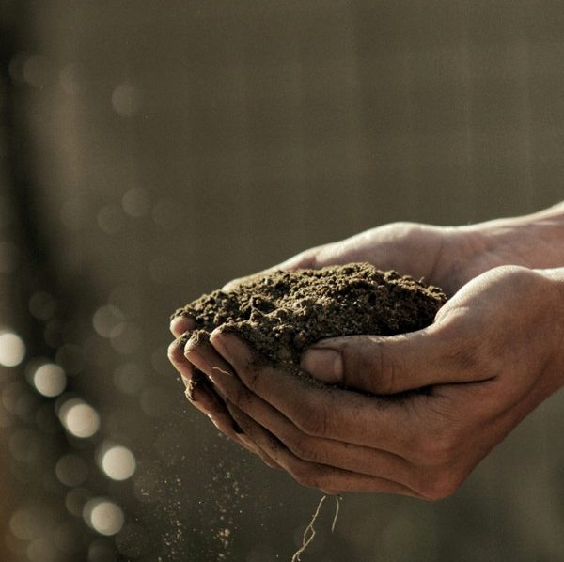
Data Sufficiency: A case study of soil data at UKCEH
Soil Sufficiency
      How much soil data is enough (or ‘sufficient’) to collect, store and use?
      Interviews and walking tours with soil stakeholders at UKCEH (archivists, EIDC staff, and soil scientists)
      Workshop with UKCEH data stakeholders to turn soil specific insights into generalized sufficiency data policies

Slide 14
Why Soil Data?
Soil Sufficiency
Context
Sufficiency is relational
Data
Underpins all science but has a substantial cost in its storage and processing – data centres and HPC.
Physical
UKCEH Science Archive – with a dedicated Soil Bank.
Digital
10% of data stored in the Environmental Information Data Centre relates to soil.

Slide 15
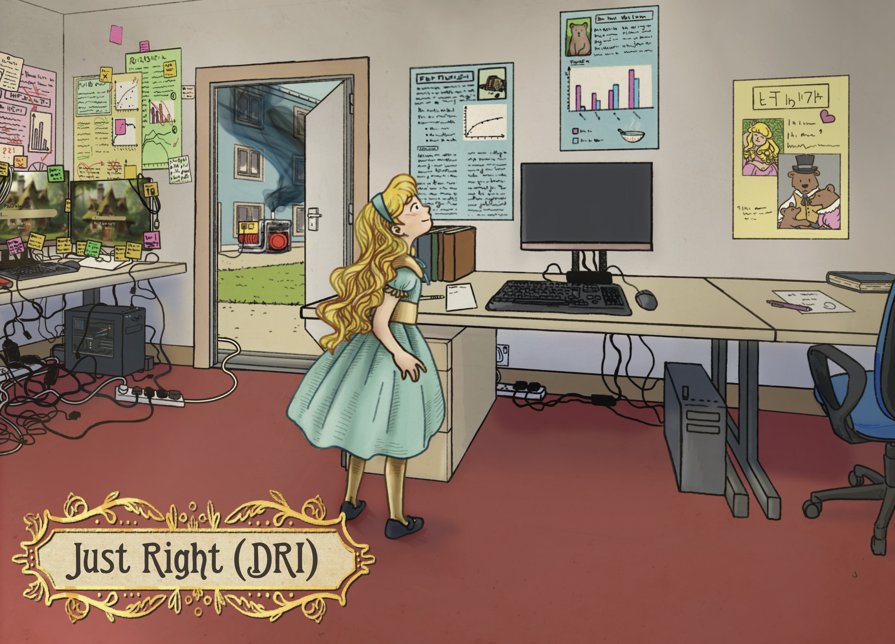
      How much data is enough to produce value in science?
      How Findable, Accessible, Interoperable and Reusable does data need to be to be valuable enough for others?
      How do we design policies that encourage less, lighter, and slower ways of doing science, that avoid waste?
      How do we build on our prior work to facilitate difficult conversations between stakeholders about this?
Credit: Véronique Heijnsbroek (visitveronique.com), 'Goldilocks and the Just Right DRI'.
Artwork developed as a part of the SDRI project. Learn more: https://tinyurl.com/SDRIyearreview

Slide 16
  Thank you.
            For more information
            please contact:
carlor@ceh.ac.uk
ceh.ac.uk
@uk_ceh

