Slide 1




UKRI and Sustainable Digital Research Activities -
Martin Farley
UKRI Associate Director of Environmental Sustainability

Slide 2

“AI infrastructure is enormously energy intensive and demand is only increasing, powering the next generation of AI infrastructure sustainably will be one of the defining challenges of the coming decade. The government is committed to delivering AI Growth Zones sustainably, ensuring impact on energy, water and wider environmental systems are considered and minimized”
“We will act with pace and purpose – but also with a clear commitment to security, sustainability, and public value.”

Slide 3
UKRI Sustainability Efforts on DRI
Infrastructure Fund Carbon Assessments
NetDrive support with:
Standard Specifications for procurement of digital services and hardware, to be shared with the sector
Training module
Champions – Check them out: Champions for Transformational Change
ICT Star Report (GGC)
PC Recycling schemes
STFC and CoSeC, EPSRC, etc.
Notes:
Replace this guidance text with your own bullet pointed content.
For further guidance please see https://www.bdadyslexia.org.uk/advice/employers/creating-a-dyslexia-friendly-workplace/dyslexia-friendly-style-guide

Slide 4
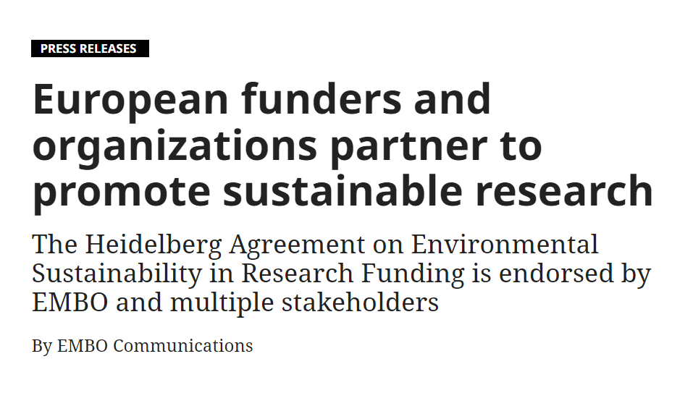

Slide 5
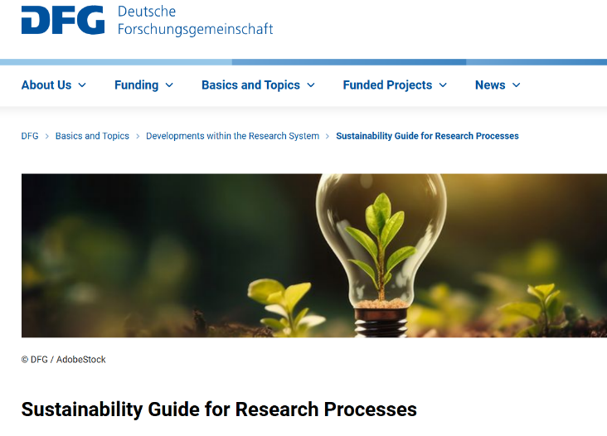
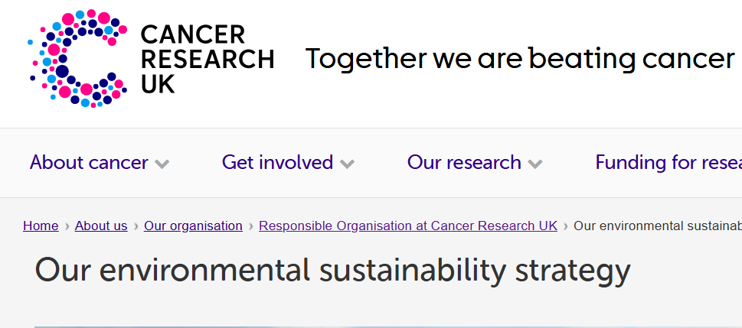
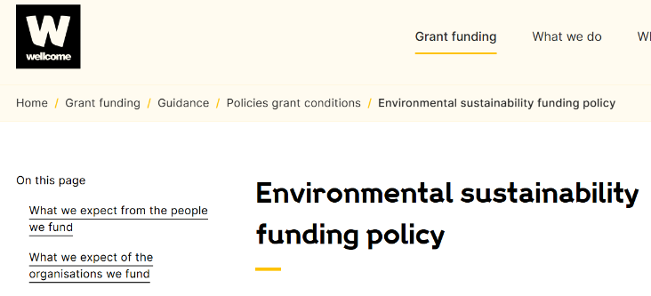
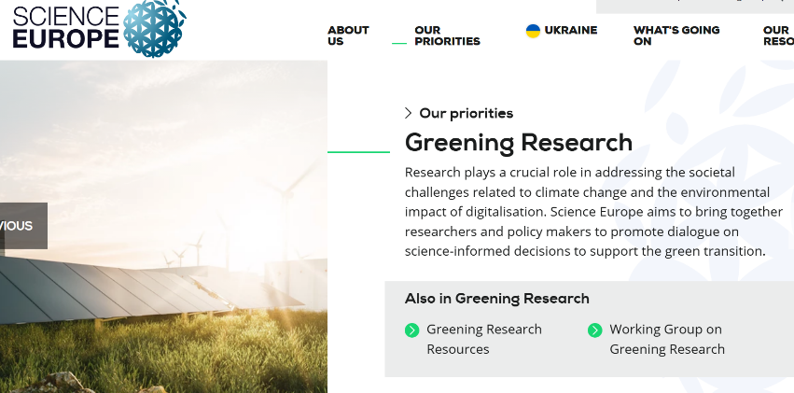

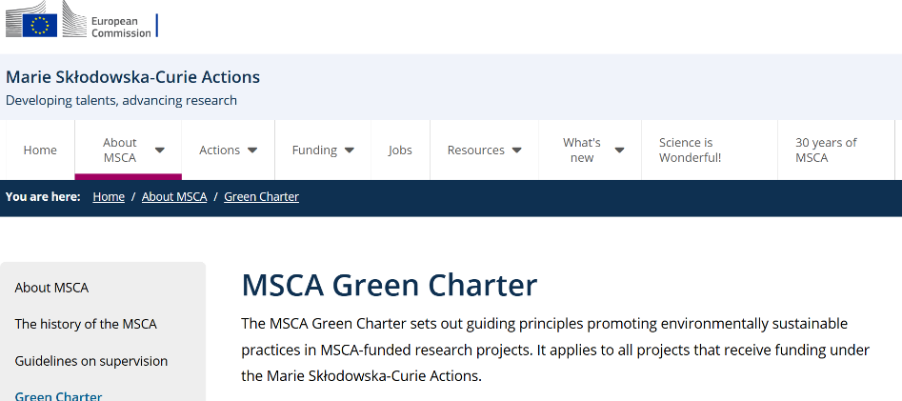

Slide 6

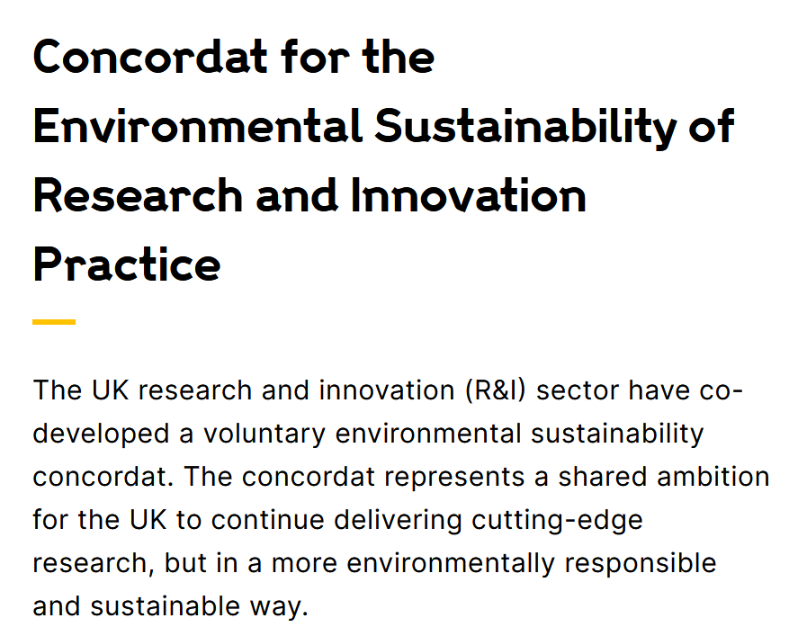

Slide 7
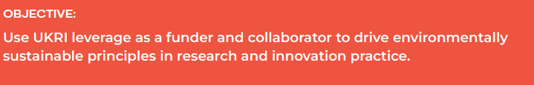
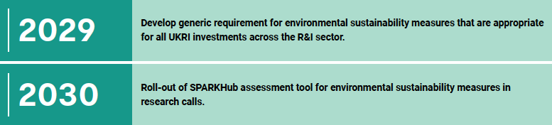
Priorities and Targets
4. Investments and Collaborations
“UKRI will ensure that our aspirations and ambitions for environmental sustainability are reflected in our approach to new funding schemes, collaborations and partnerships”
“Consultation internally and with other funders will lead to aligned expectations on environmental sustainability in funding applications and assessments…”

Slide 8

What is it?
Mechanism to drive Sustainable Research
Certification to cover all research activities, and which is modular depending on activity
Covers activity for groups and organisations
Will host Calculators & Training resources
How will it be managed?
Validated auditing
Supported by Research Funders
Content is quality-managed by elected board of experts
All content is free and open-access. Certification is free for public sector

Slide 9

Governance Model
*3-5 year initial agreement
Governance Board
Research Funding Organisations
Host
Delivers SPARKHub
Content Review Board Oversight for Content
Quality
Notes:
Replace this guidance text with your own bullet pointed content.
For further guidance please see https://www.bdadyslexia.org.uk/advice/employers/creating-a-dyslexia-friendly-workplace/dyslexia-friendly-style-guide

Slide 10

Making sustainability ‘easy’ and accessible for all researchers
Open Access
and easy to use
Standardized
Measures
Financed by funders
Certification
Training
Content by Researchers & Experts
Impact Calculators
Quality control of certification through peer-to-peer review
Case Studies
UKRI Environmental Sustainability Strategy Target: “Roll-out of SPARKHub assessment tool for environmental sustainability measures in research calls.”

Slide 11
Research Activity | Source
Wet Laboratory (add on for life sci & biobanks) | V. Scagliotti, P. Weber, B. Schell. K. HS, UoE
Imaging / Flow Cytometry | Euro Bioimaging / GSTT
Clinical Trial Units | UKCRC / KCL
Digital Services & AI | Green-DiSC
Diagnostics & Pathology | Ashling Coakley-Burns, Kelly Nijhof
Laser Labs | UKRI / UoManchester
Mechanical Engineering | MMU
Animal Facilities / Drosophila | MRC, ETH Zurich
Chemical Sciences | Thomas Freese, RSC, ACS colleagues
Travel / Conferences / Field Work | UKRI, TBC
Offices, Procurement | UKRI
Workshops, Arts (Print, Wood/metal, etc) | University Arts London
Sports Science | UoBirmingham
Genomics | UoManchester
Mass Spectrometry | Caroline Pollard, Helena Rapp Wright
Institutional Guidance, teaching | EMBO Workshop / UKRI
Humanities | DHCC (tbc) & UoBirmingham
Notes:
Replace this guidance text with your own bullet pointed content.
For further guidance please see https://www.bdadyslexia.org.uk/advice/employers/creating-a-dyslexia-friendly-workplace/dyslexia-friendly-style-guide

Slide 12


Slide 13
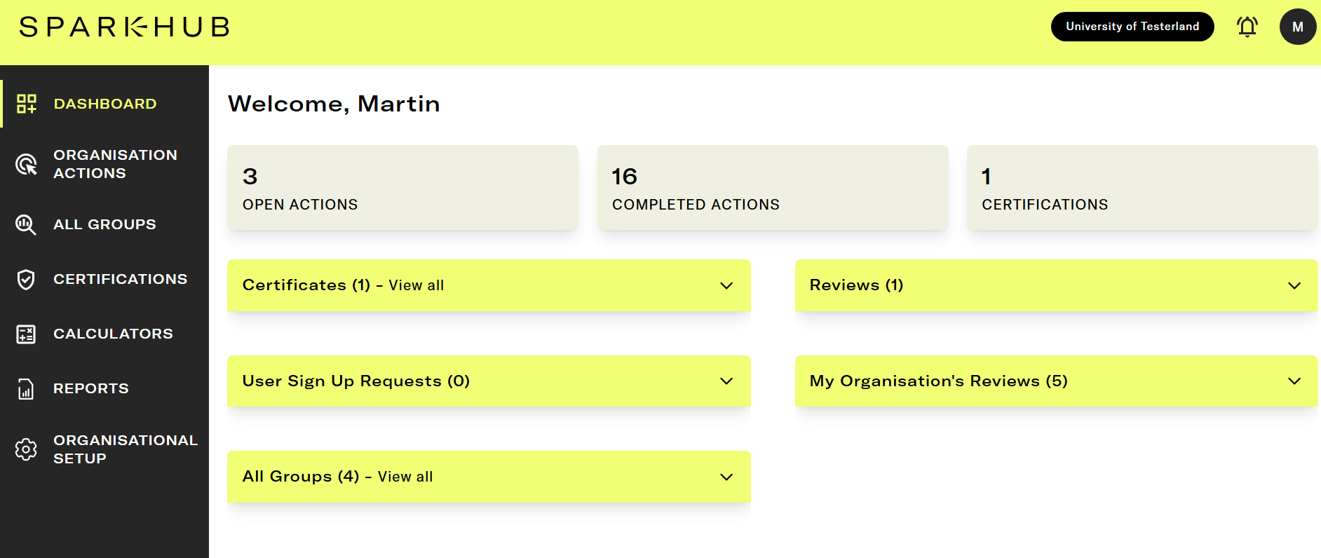

Slide 14
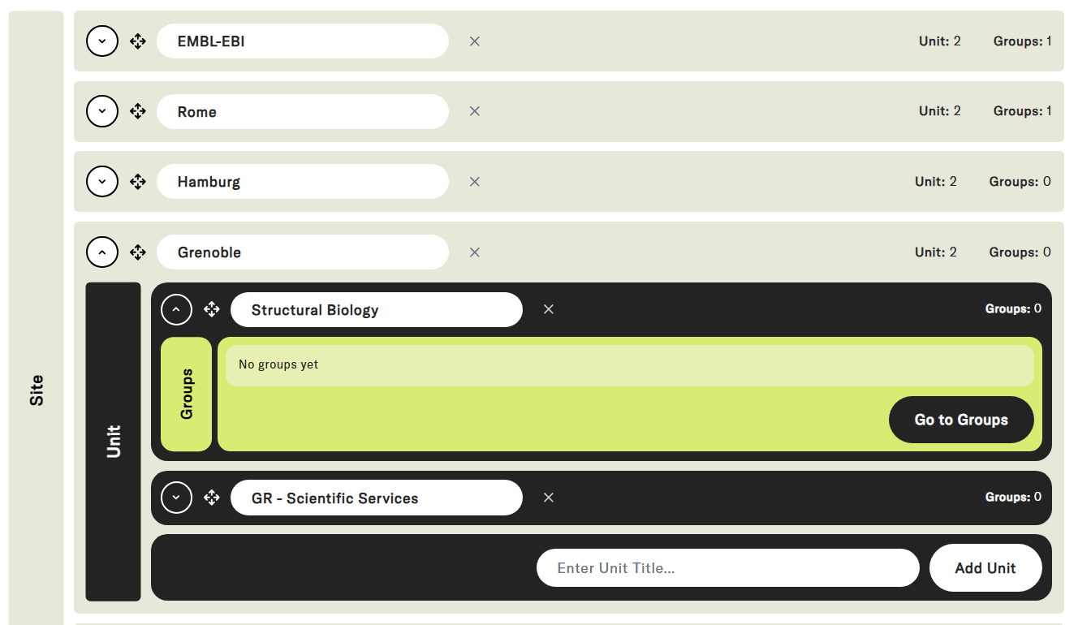

Slide 15
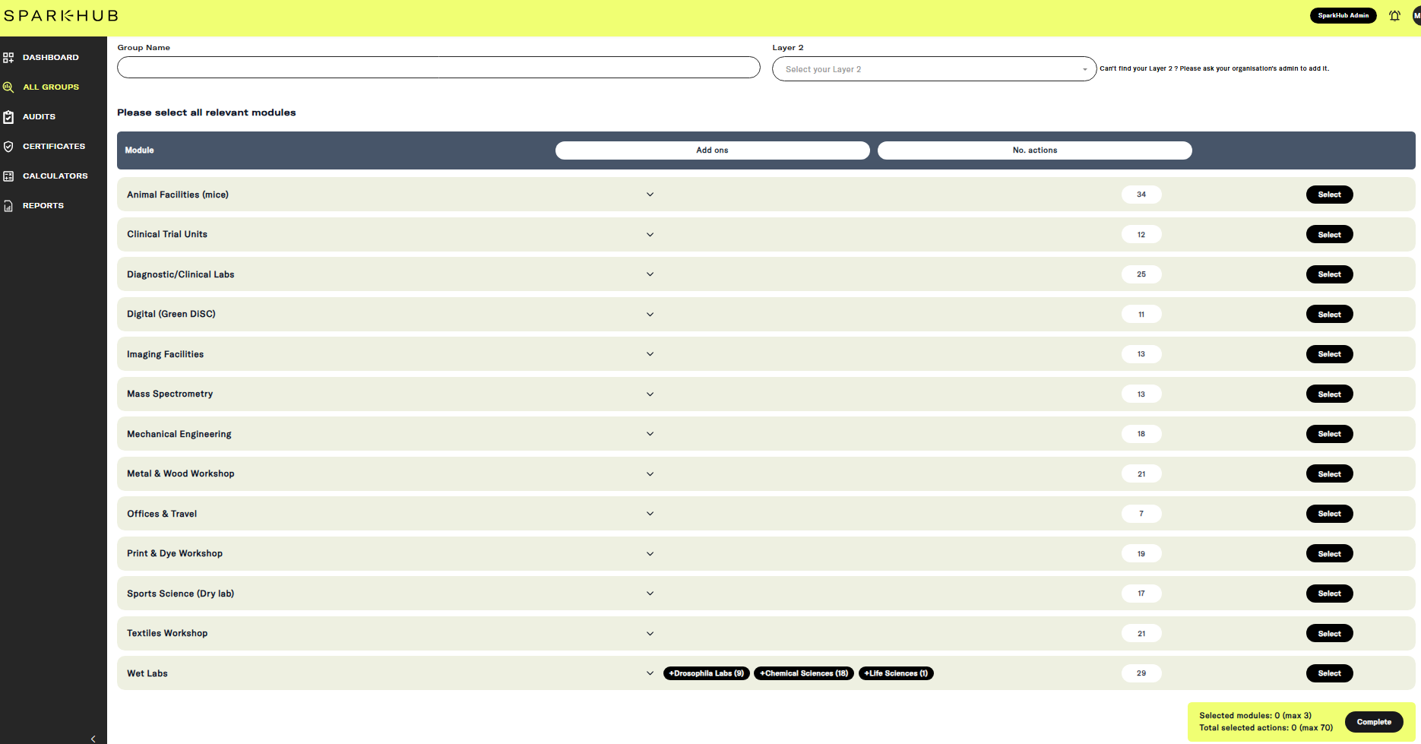

Slide 16
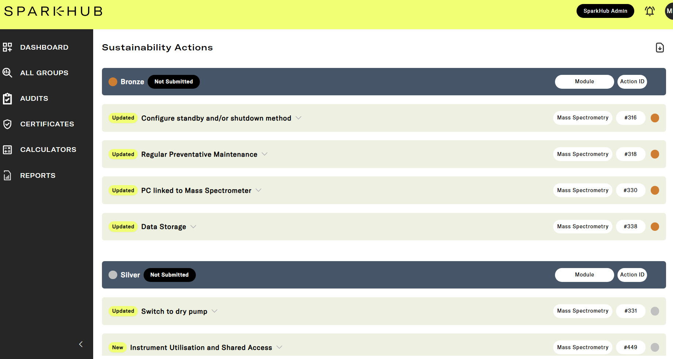

Slide 17
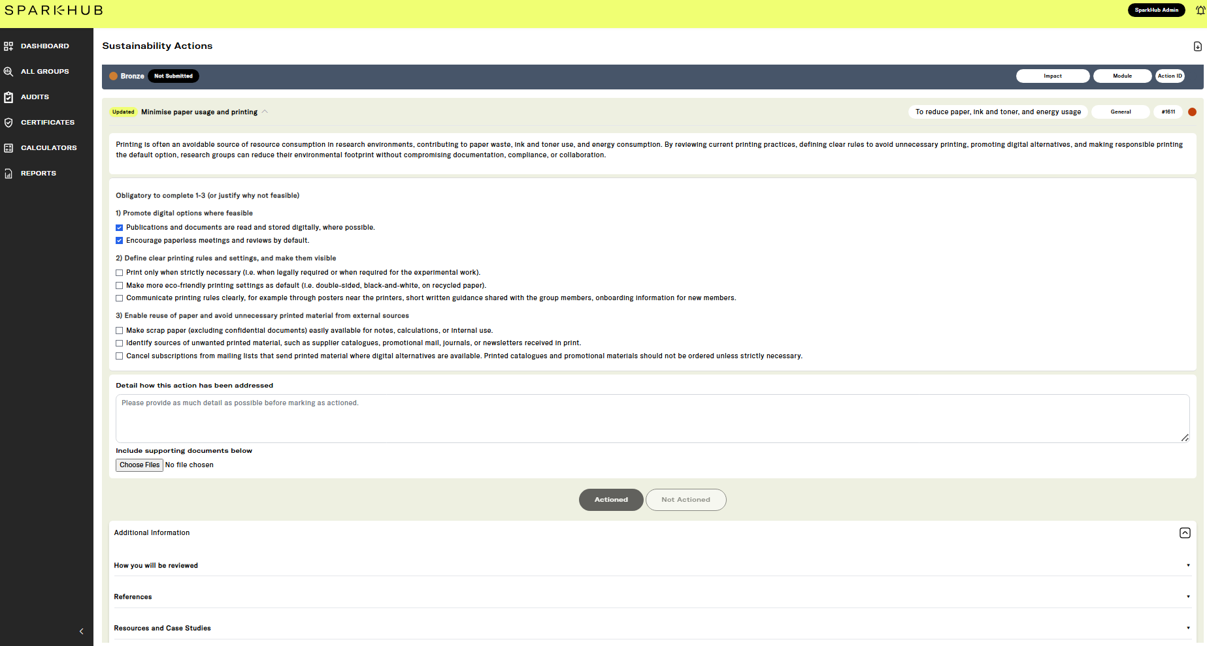

Slide 18
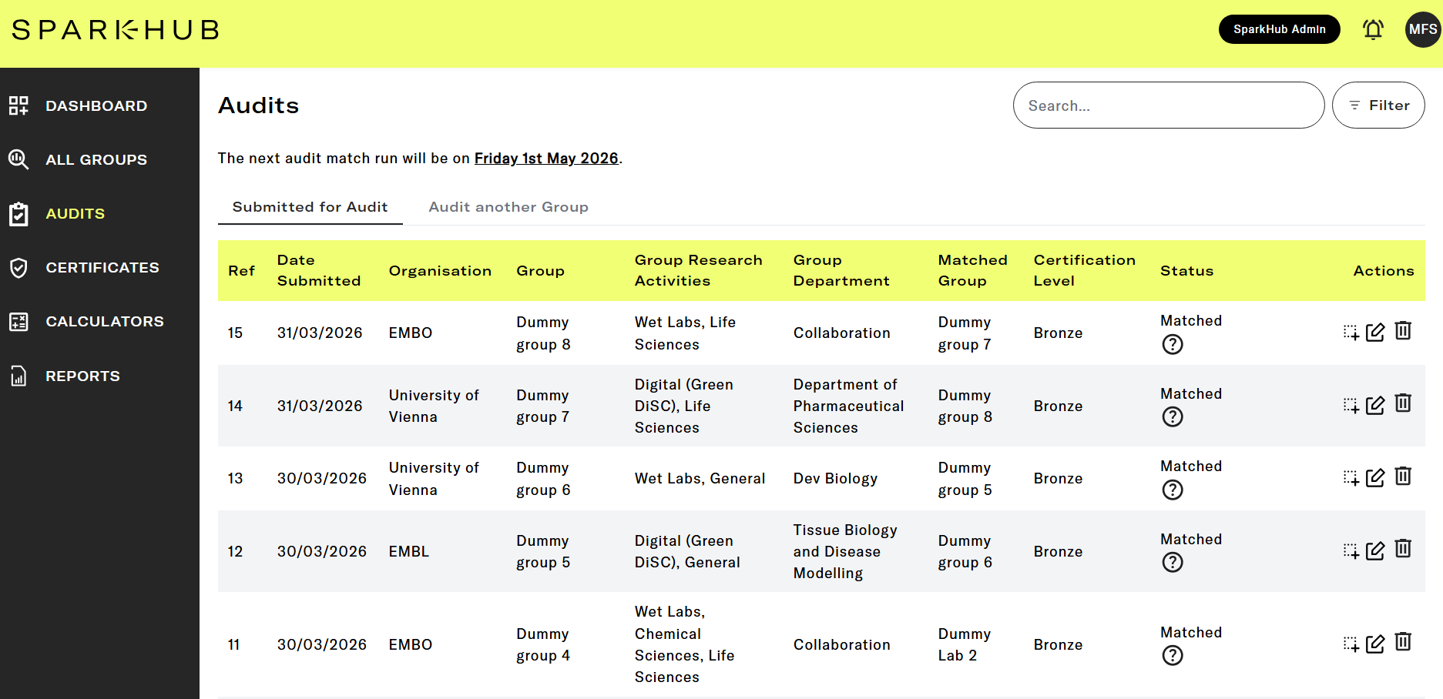

Slide 19
Research Group A
Allows knowledge exchange between experts
Allows programme to grow with low overheads
Ensure some quality assurance
Research Group B
Audit Cycles
Research Group C
SPARKHub Quality Assurance Check for Supporting Funders

Slide 20

To be displayed publicly, so that each funder can see who has participated, with a unique identifier

Slide 21
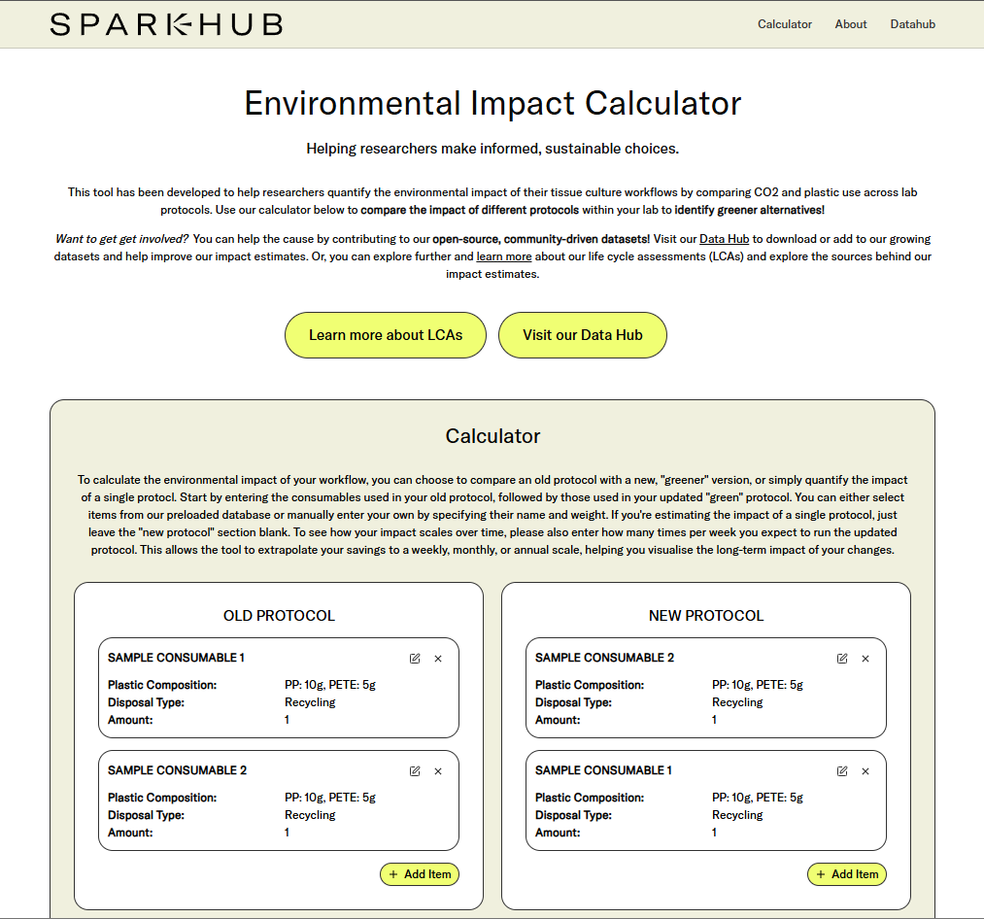

Slide 22
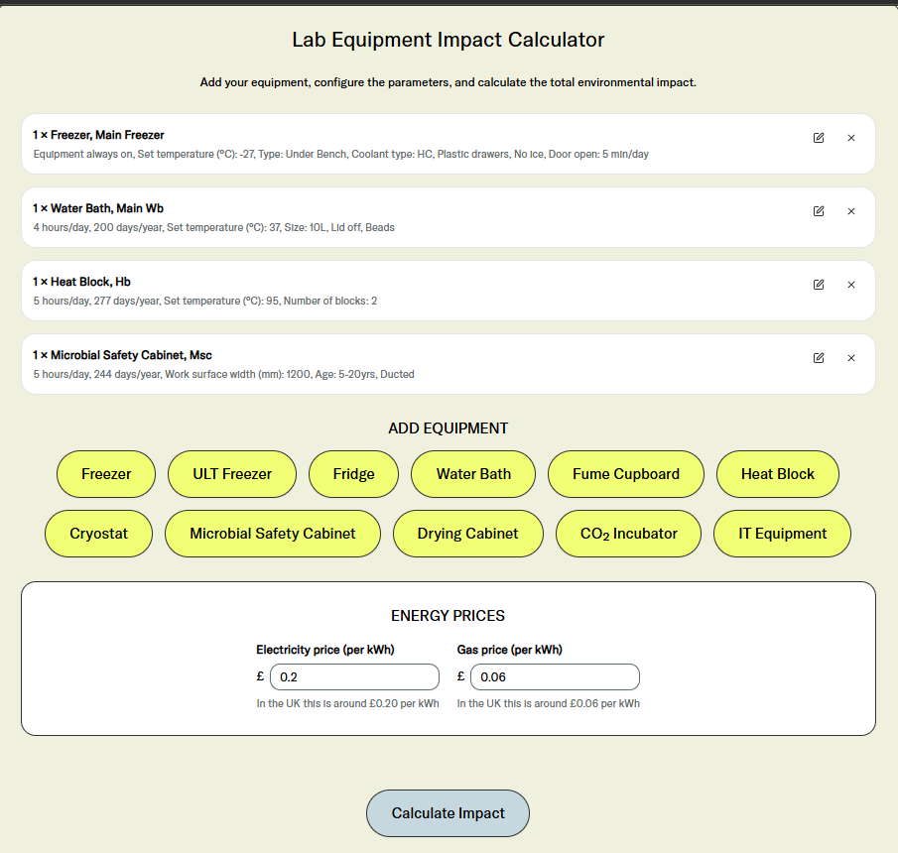
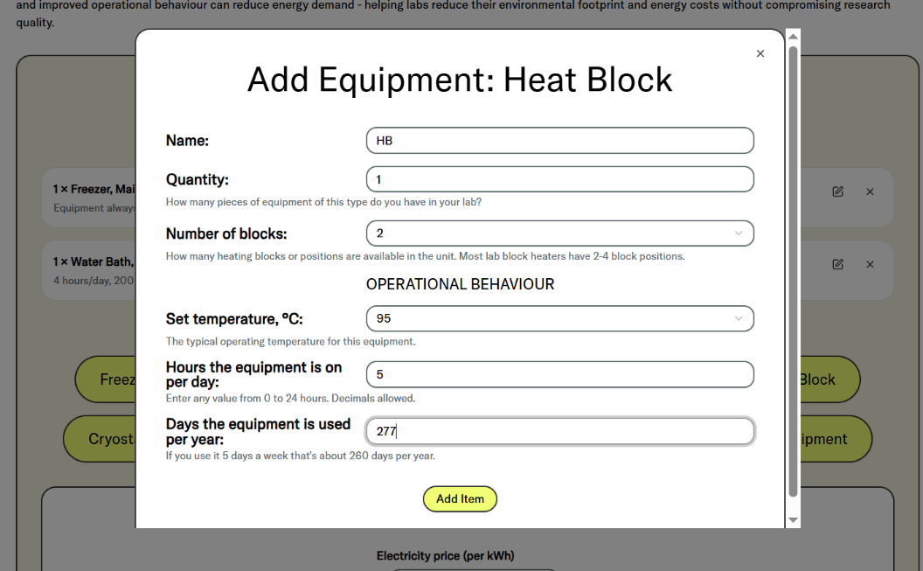
Credit to:
Isobel Taylor-Hearn & Alexa Powell for dev/structuring
Andy Evans for metering source of equipment data

Slide 23
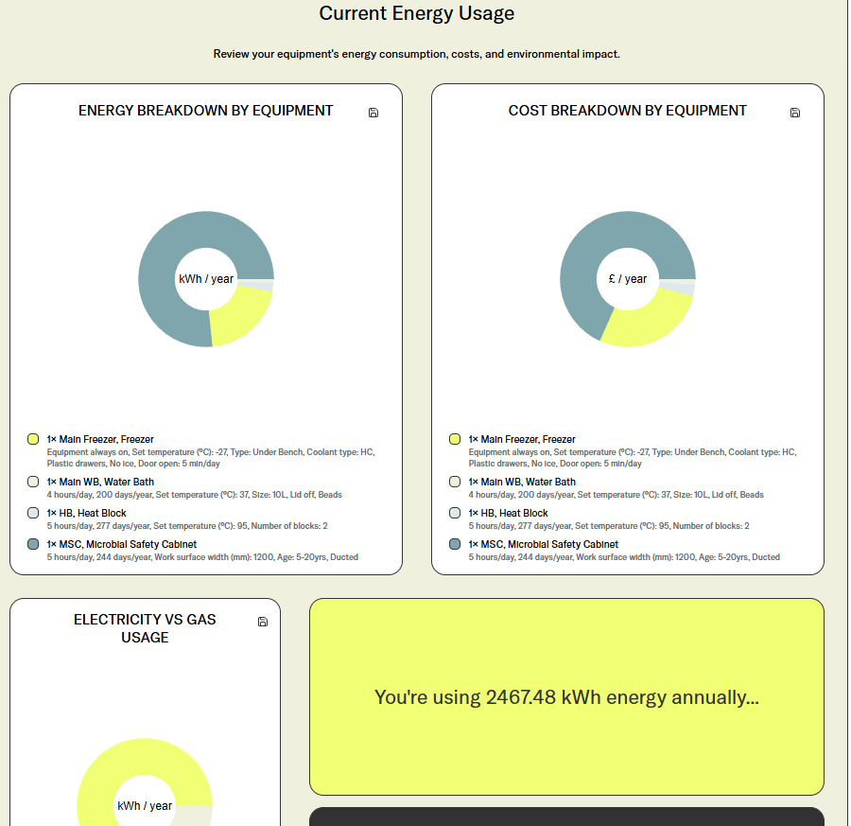
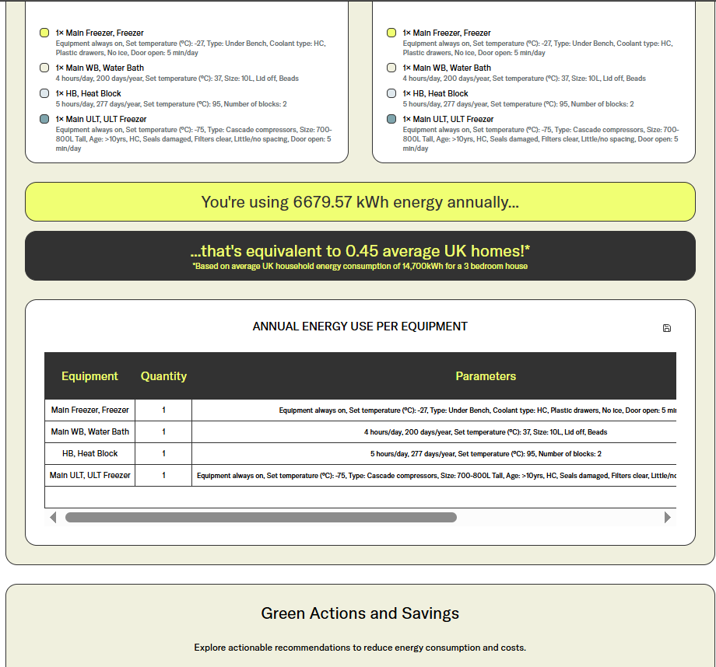

Slide 24
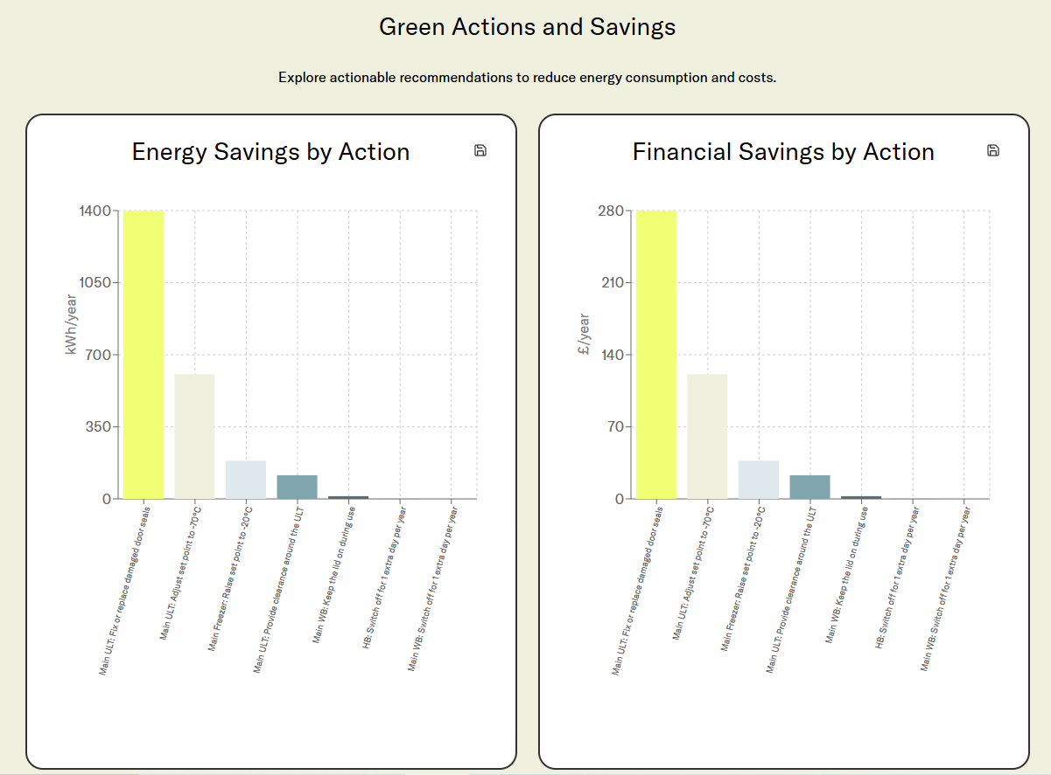

Slide 25
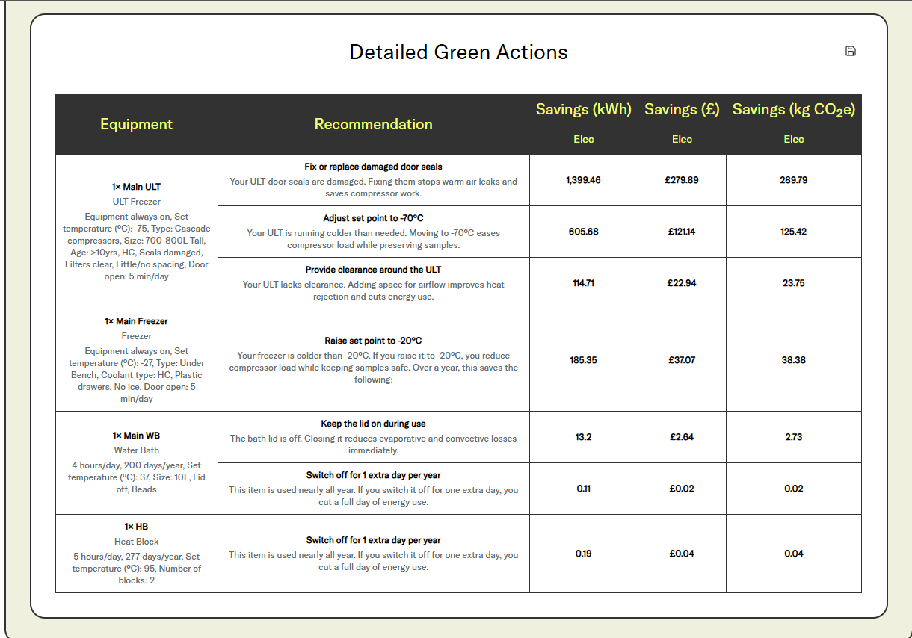

Slide 26
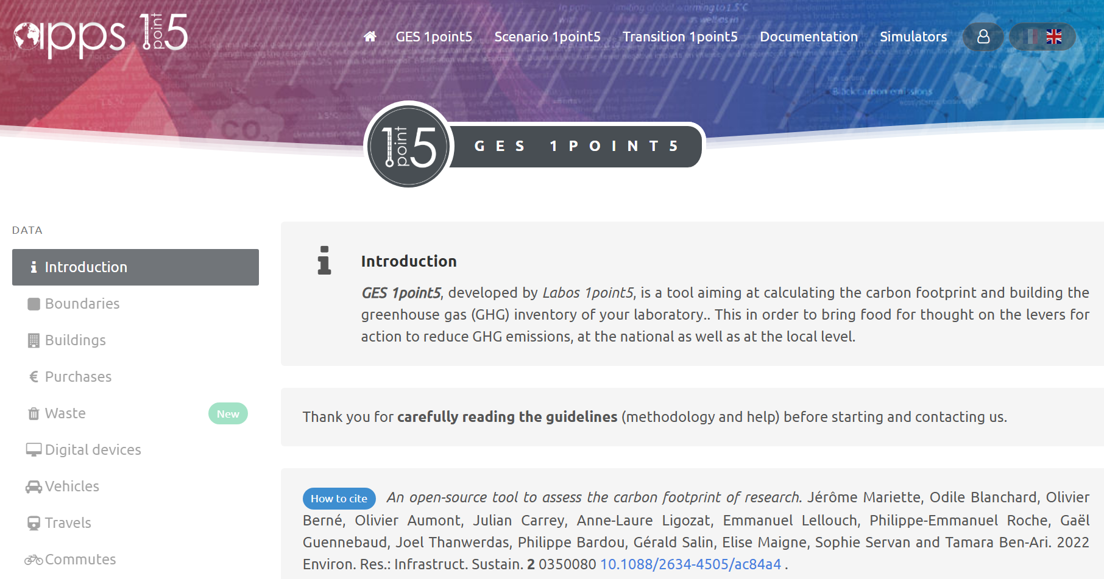

Slide 27
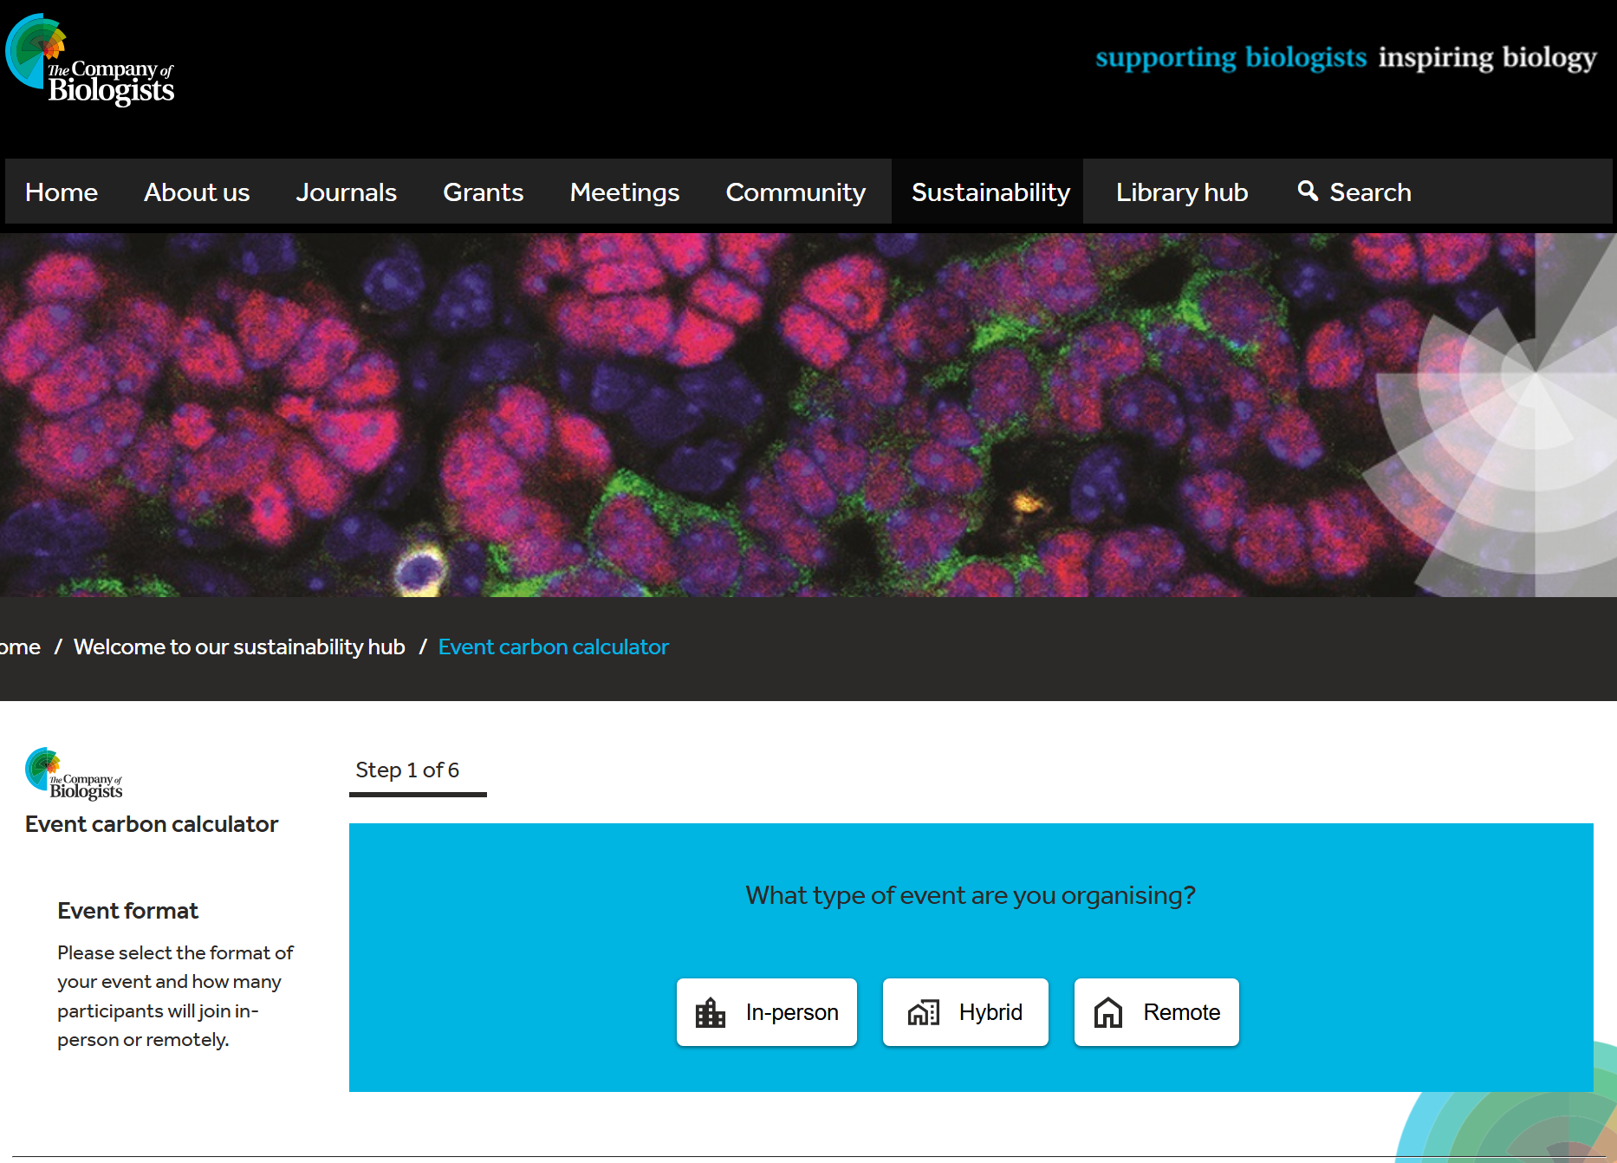

Slide 28
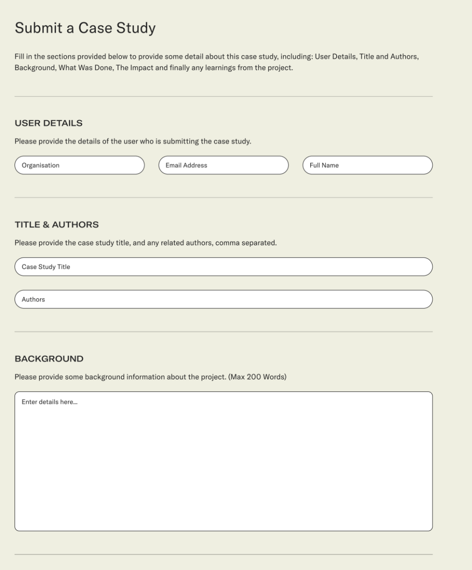
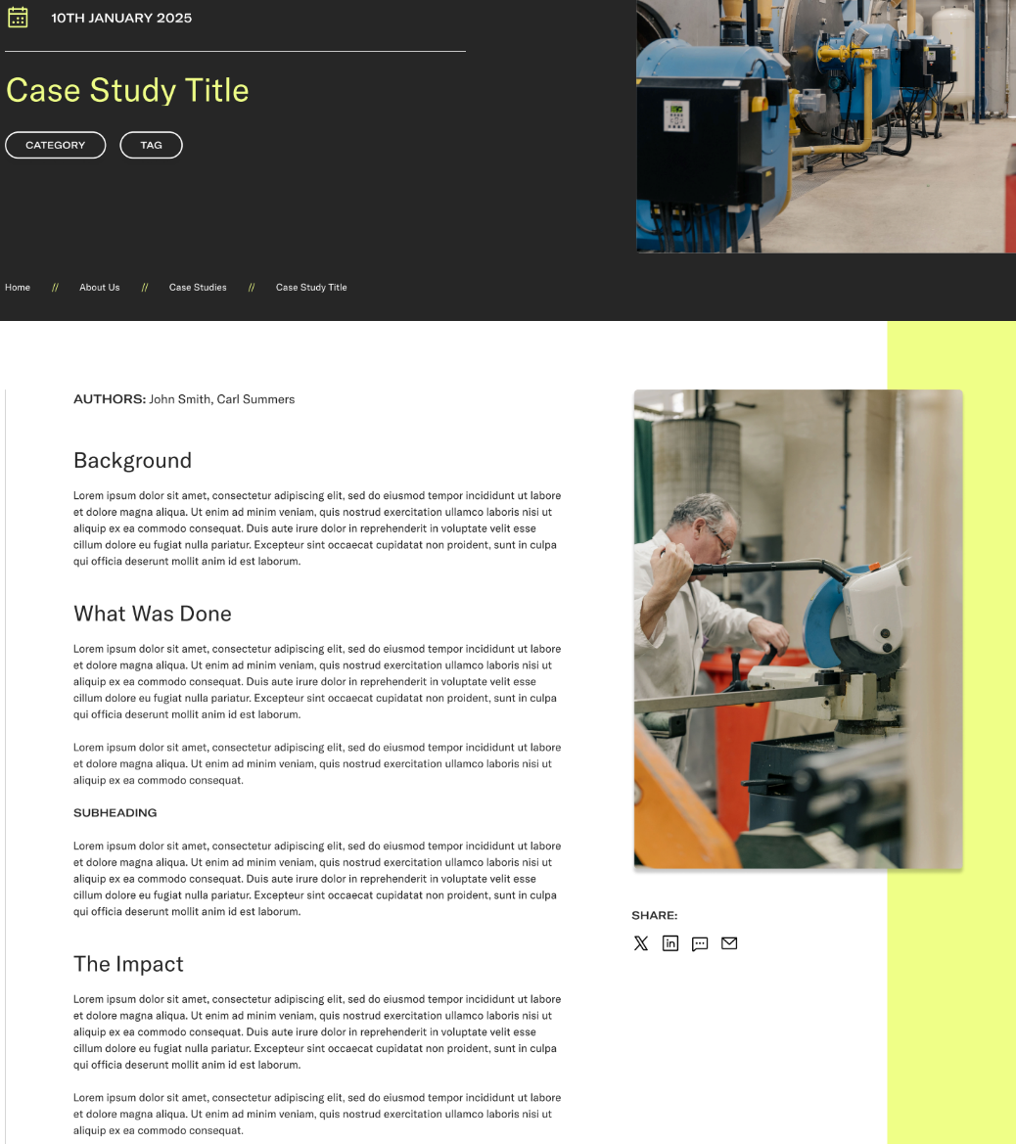
Focus should be sustainable research. It should be oriented not just around a single-supplier

Slide 29
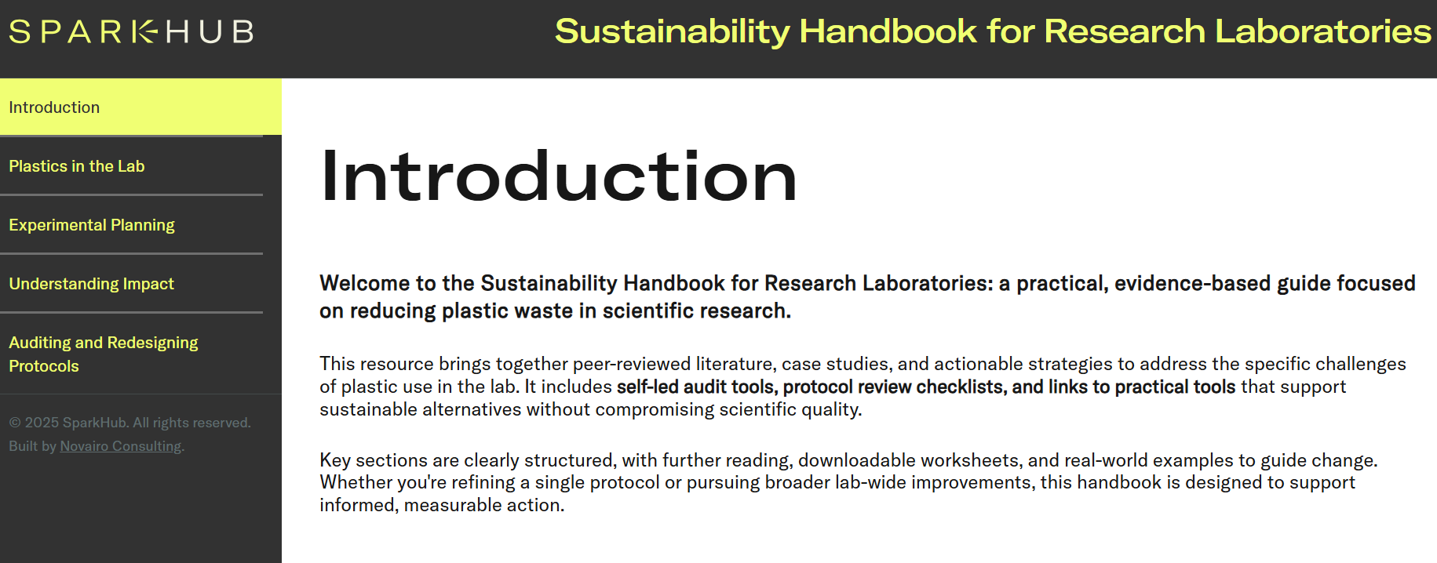

Slide 30
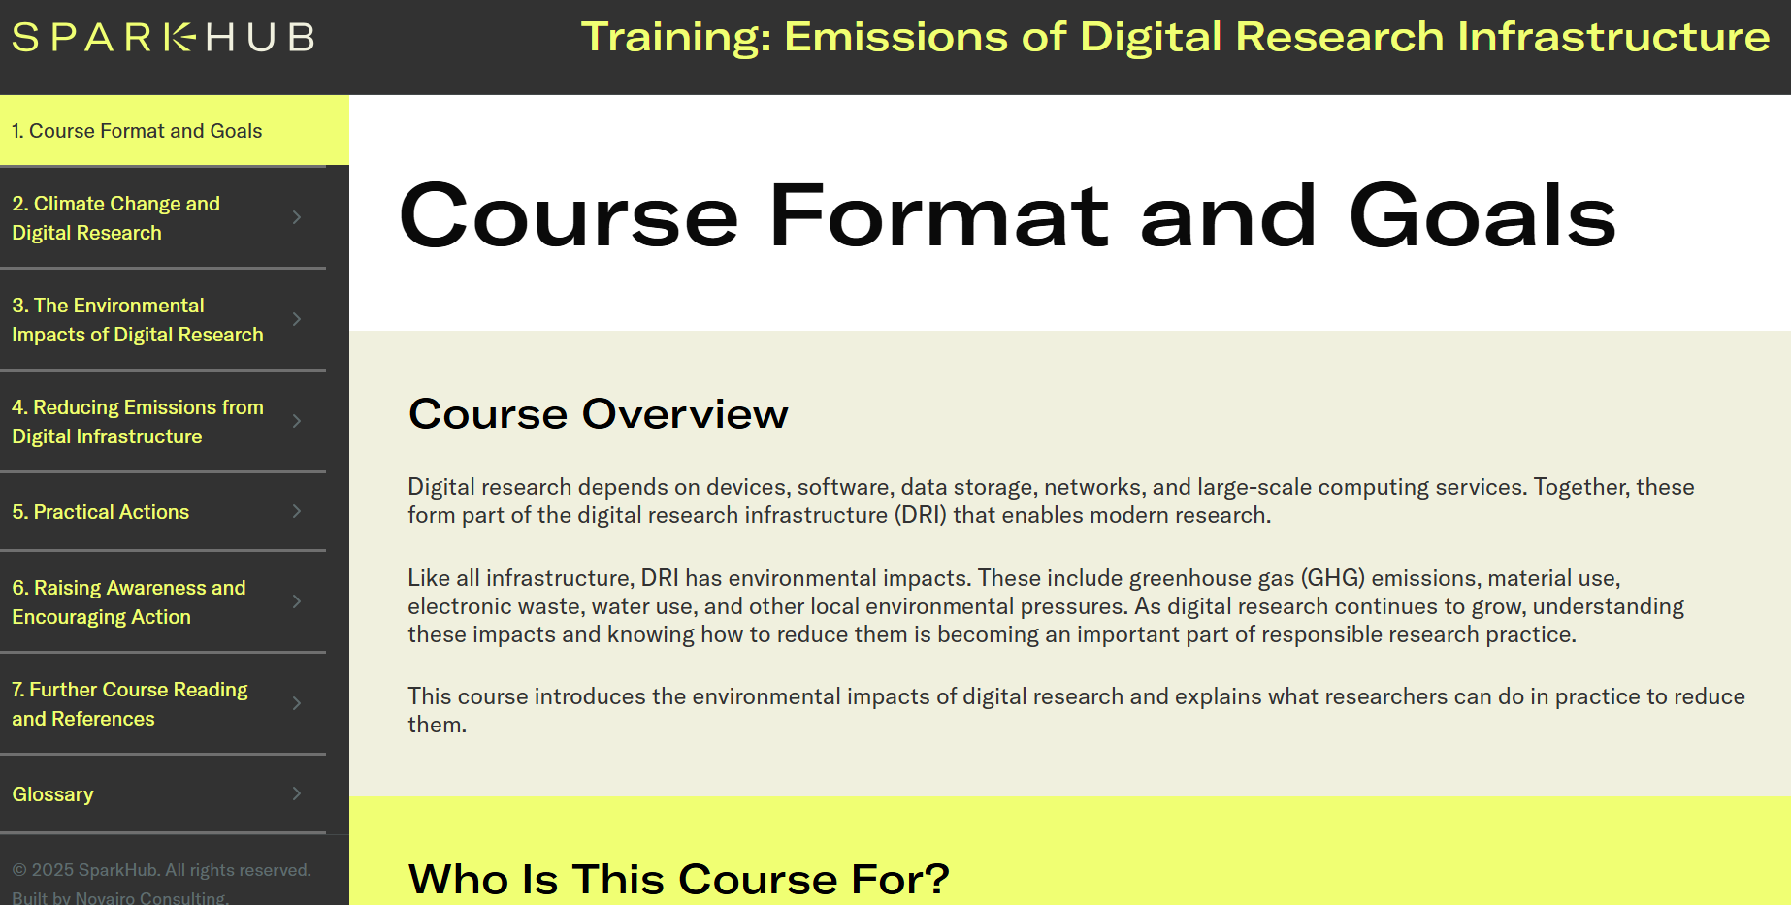

Slide 31
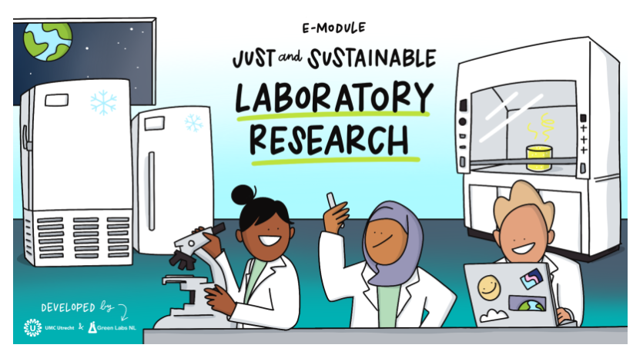

Slide 32

Organisational Resources:
Ventilation Systems guidance
Equipment & Furniture Sharing
Sample, chemical, gas management systems
Waste Specifications and guidance
Procurement – Prewritten specifications for DRI now live on sparkhub.eu
IT Management – Facility management guidance tbd
Building & Refurbishment standards
Training, JD Requirements, Objectives
Travel & Transport pathway
Engagement, Governance
Research Bid Development

Slide 33
Timeline and what’s next
Beta website pilot on invite only will take place over summer – Launch in the fall for full website
SPARKHub.eu now live
Submit your case studies ☺
Contact: martin.farley@ukri.org
Notes:
Replace this guidance text with your own bullet pointed content.
For further guidance please see https://www.bdadyslexia.org.uk/advice/employers/creating-a-dyslexia-friendly-workplace/dyslexia-friendly-style-guide

Slide 34
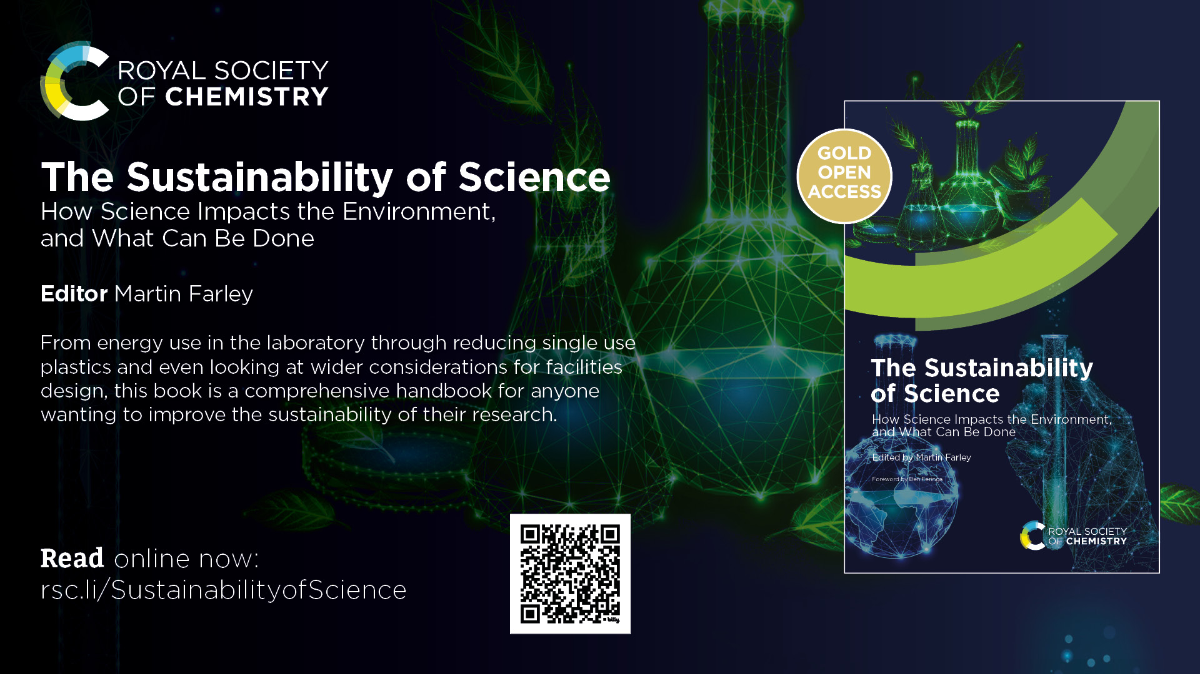
Free open-access chapter on sustainable digital activity by Deirdre Black

Slide 35





Notes:
To edit the background image, select ‘Format’ from the PowerPoint menu and ‘Slide Background’ from the drop-down menu. Within the new list of options that appears on the right of the screen, select the ‘File’ button under ‘Insert picture from’ and select your image from your file browser.
The abstract pattern can be removed or repositioned if required. Be careful to ‘Send to Back’ so that it does not obscure any important information.

